Slide 1
Whimsical Creatures

Slide 2
Oaxacan
With woodcarving origins in the traditions of carved festival masks, Alibrijes are small sculptures with their origin in children's toys and talismans. ... They are conceived as creatures from dreams, carved with machete and smaller knives from copal wood and intricately painted with enamels.
.

Slide 3
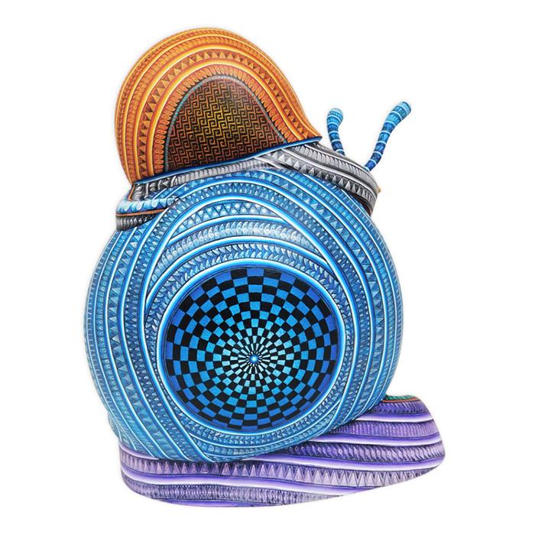
Javier Jimenez: Masterpiece Snails
14.5''Tall 13''Long 11''Wide

Slide 4
Rocio Fabian: Exquisite Tarsier 9''Tall 8''Long 7''Wide

Slide 5
Aldo Hernandez-Casa Don Juan: Magnificent Dog 8''Tall 8''Long 4''Wide

Slide 6
Manuel Cruz: Jaguar 5''Tall 10''Long 3''Wide

Slide 7
Manuel Cruz: Elephant & Baby 8.5''Tall 9''Long 7.5''Wide

Slide 8
Luis Sosa: Spectacular Lemur 13.5''Tall 12''Long 5''Wide

Slide 9
Oaxacan wood carving by Blas family 8X10”

Slide 10
Zeny Fuentes, Red Buffalo 13 1/2"L x 7 1/2"W x 10”H

Slide 11
Coyote Alebrije, By Manuel Cruz 18″ tall 11.5″ long and 8″ wide

Slide 12
Zapotec Octopus 12" x 6" x 11"

Slide 13
Ivan & Mayte Fuentes armadillo Length/Height/Width: 11" x 9" x 5"

Slide 14
Peacock by Reyna Piña from Oaxaca, Mexico 17” x 15” x 6”.

Slide 15
Sosa family in Oaxaca Mexico Reading Frog 9" x 6.5" x 5"

Slide 16
Crab by Jose Calvo & Magaly Fuentes 9" x 7.5" x 7”

Slide 17
Notice the spikes on this sculpture. Could you use tooth picks?
Signed by artist. Purchased by Ms. Beach around 2003

Slide 18
Alebrijes
What are alebrijes?
The alebrije is a Mexican handicraft traditionally made with the cardboard technique . It is a fantastic figure that combines physiognomic elements of various animals, whether real or imaginary, and is characterized by being painted in vibrant colors.
And how do you make an alebrije? It all starts with a base of burnt wire that is bent and molded to form the skeleton of the figure. Later it is covered with several layers of newspaper and paste, using cardboard to give it volume. The base figure is left to dry in the sun, and once it dries, more detailed elements are added, such as eyes, beaks, wings and claws.

Slide 19
Jan Huling, American b 1953 Giant Praying Mantis Form Covered in Glass Seed Beads2015 Height: 61 in. (154.94 cm)Width: 110 in. (279.4 cm)Depth: 59 in. (149.86 cm)

Slide 20
Alebrije created by Pedro Linares López in 1986.

Slide 21
Reference
https://www.mexican-folk-art-guide.com/Oaxacan-wood-carvings.html#.YDcVlHdKhmA
https://www.oaxacaoriginal.com/

