Slide 1
pears
Still-life collage by
Penny Feder

Slide 2
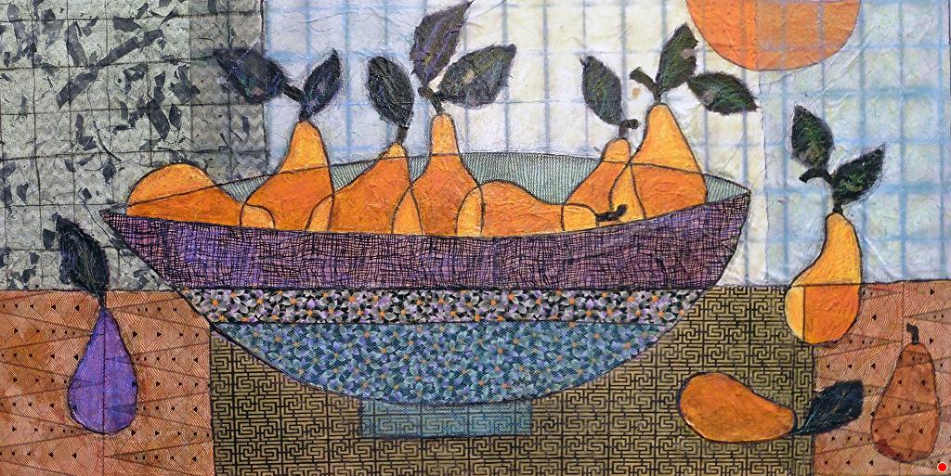
Penny Feder, American
“Long Purple Pears”
date not given
Mixed Media Collage on canvas
24”x48”x1½”
https://pennyfeder.com/portfolio-viewer?collection=107803#lg=1&artworkId=2610442

Slide 3
DESCRIBE
How did the artist used geometric shapes in this collage still-life?
REMEMBER
Give details! Remember to defend your answer using complete sentences.

Slide 4
ANALYZE
How did the artist use repetition in this collage still-life? give two examples
REMEMBER
Give details! Remember to defend your answer using complete sentences.

Slide 5
INTERPRET
Why is one of the pears a different color from the rest of the pears?
REMEMBER
Give details! Remember to defend your answer using complete sentences.

Slide 6
JUDGE
How did the artist use mixed media in this still-life?
REMEMBER
Give details! Remember to defend your answer using complete sentences.

