Slide 1
Apples
Watercolor Still-life by
Yachiyo Beck

Slide 2
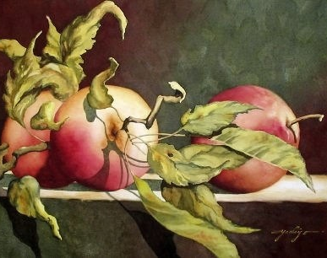
Yachiyo Beck, Japanese
“Apples”
Watercolor on Paper
date not given 22" x 30”
https://yachiyofineart.com/portfolio-viewer?collection=85106#lg=1&artworkId=1957505

Slide 3
DESCRIBE
What groups of shapes do you see in this still-life painting?
REMEMBER
Give details! Remember to defend your answer using complete sentences.

Slide 4
ANALYZE
What type balance did the artist use in this still-life painting?
REMEMBER
Give details! Remember to defend your answer using complete sentences.

Slide 5
INTERPRET
Why did the artist include leaves on the apple stems?
REMEMBER
Give details! Remember to defend your answer using complete sentences.

Slide 6
JUDGE
How well did the artist show shadows in this still-life watercolor painting?
REMEMBER
Give details! Remember to defend your answer using complete sentences.

