Slide 1
Frank Stella The Grand Armada “What you see is what you see.”
Warm-up 3

Slide 2
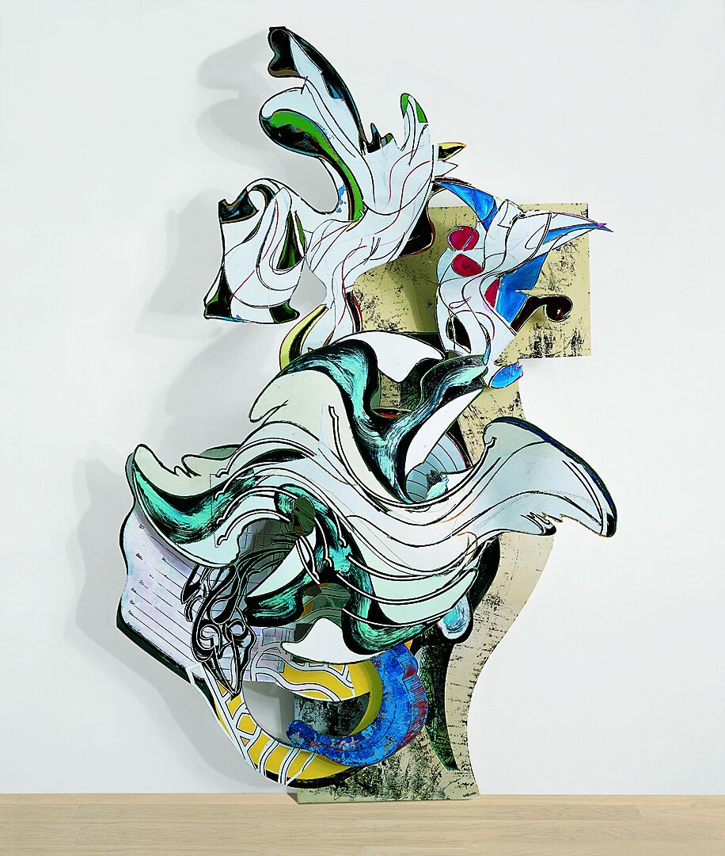
Frank Stella, American, b. 1936
The Grand Armada (IRS-6, 1X)
1989.
Aluminium relief, painted, five parts
315 × 186.5 × 99 cm
image found on https://whitney.org/education/for-teachers/teacher-guides/frank-stella

Slide 3
DESCRIBE
What you see in the foreground, middle ground, and background in this sculpture
Write your answers with complete sentences that give specific details.

Slide 4
ANALYZE
Which three principles of design do you think the artist used for this composition? write a sentence for each.
Write your answers with complete sentences that give specific details.

Slide 5
INTERPRET
Stella used the book Moby-Dick to inspire the design for this sculpture.
What emotions do you believe the artist was trying to say in this composition?
Write your answers with complete sentences that give specific details.

Slide 6
JUDGE
How well did Stella convey a sense of the whale hunt through line, shape, color, movement, and energy?
Write your answers with complete sentences that give specific details.

