Slide 1
Frank Stella
K.304
Warm-up

Slide 2
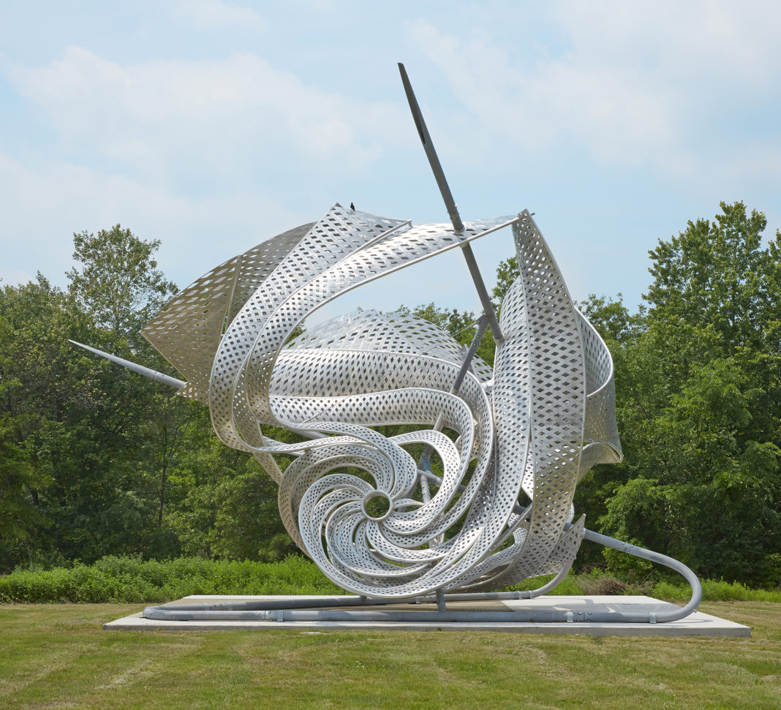
Frank Stella, American, b. 1936
K.304
2013
Aluminum and stainless steel
920 x 1270 x 1170 cm. (30 x 41 x 39ft)
https://www.creativeboom.com/inspiration/work-of-frank-stella-celebrated-in-captivating-new-book-/

Slide 3
DESCRIBE
What do you you see in this sculpture?
Give details! Remember to defend your answer using complete sentences.

Slide 4
ANALYZE
How did the artist use line, form, balance, and pattern in this artwork?
Give details! Remember to defend your answer using complete sentences.

Slide 5
IINTERPRET
What do the forms represent?
Give details! Remember to defend your answer using complete sentences.

Slide 6
JUDGE
How well did the artist used visual movement in this artwork?
Give details! Remember to defend your answer using complete sentences.

