Slide 1
Principles of Design
Cornell notes

Slide 2
You will be using your “Principles of Design” worksheet to take notes from this presentation.
YOU MUST USE COLOR PENCILS or color gel pens for these notes.

Slide 3
With each Principle of Design you will change the color pencil, gel pens, or font (if typing) being used for the notes!
You do not have to use the same color in this presentation. DO USE YELLOW, but what ever color use use for each Principle all notes for that Principle must be done in the color you chose.
MindMap© map notes are taken in the same way with colors and images. What you are doing today connects MindMap© with Cornell notes.

Slide 4
BALANCE
Select a color pencil or gel pen to take your notes. May be any color except yellow. If typing on a computer select a color for your font.

Slide 5
BALANCE
Symmetrical/Formal
Two halves of a balanced composition are identical.
Asymmetrical/Informal Equal or very similar, elements are placed on opposite sides of a central axis.
In this space you will add your own illustrations for each type of balance. You may not just copy the illustrations in this presentation!
The manipulation of subject matter that makes the audiences brain say they are balanced.
Radial When the forms or elements of a design come out (radiate) from a central point

Slide 6
EMPHASIS
Select a new color to take your notes. May be any color except yellow or a color already used for this worksheet.

Slide 7
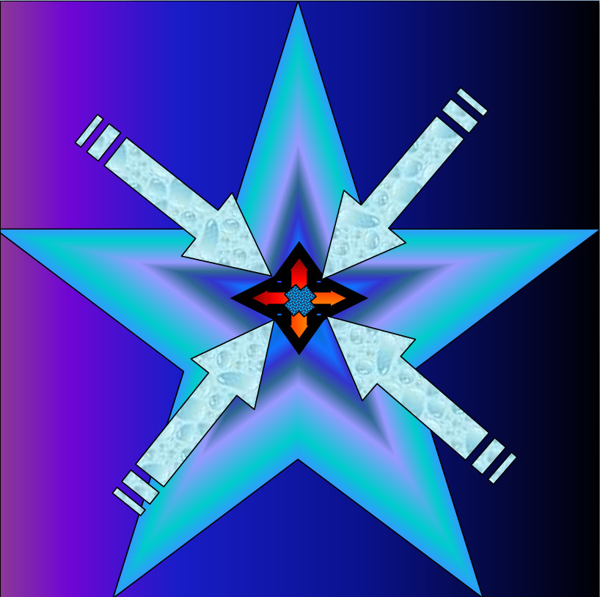
EMPHASIS
In this space you will add your own illustration to show EMPHASIS. You may not just copy the illustrations in this presentation!
Is the part of the design that catches the viewer’s attention.

Slide 8
MOVEMENT
Select a new color to take your notes. May be any color except yellow or a color already used for this worksheet.

Slide 9
MOVEMENT
Kinetic
Types you might see - frozen, flowing, sporadic…..
Used to create the look and feeling of action and to guide the viewer’s eye throughout the work of art.
Physically moves
In this space you will add your own illustrations for each type of balance. You may not just copy the illustrations in this presentation!
Visual
How your eyes perceive the movement

Slide 10
PATTERN
Select a new color to take your notes. May be any color except yellow or a color already used for this worksheet.

Slide 11
PATTERN
An arrangement of repeated or corresponding parts. Can be shapes, colors, texture….
In this space you will add your own illustrations for each type of balance. You may not just copy the illustrations in this presentation!
is the repeating of an object or symbol all over the work of art.

Slide 12
REPETITION
Select a new color to take your notes. May be any color except yellow or a color already used for this worksheet.

Slide 13
REPETITION
Items repeated do not have to be the same size or colors.
works with pattern to make the work of art seem active. The repetition
of elements of design creates unity within the work of art.
In this space you will add your own illustrations for each type of balance. You may not just copy the illustrations in this presentation!

Slide 14
PROPORTION
Select a new color to take your notes. May be any color except yellow or a color already used for this worksheet.

Slide 15
PROPORTION
Concerned with the size relationships of one part to another.
In this space you will add your own illustrations for each type of balance. You may not just copy the illustrations in this presentation!

Slide 16
RHYTHM
Select a new color to take your notes. May be any color except yellow or a color already used for this worksheet.

Slide 17
RHYTHM
Repetitive alternating
1,2,1,2,1,2,1,2,…...
In this space you will add your own illustrations for each type of balance. You may not just copy the illustrations in this presentation!
Repetitive progressive
1,2,3,4,1,2,3,4,1,2,3,4…
Visual rhythm is perceived through the eyes and is created by repeating positive spaces separated by negative spaces.
Repetitive, alternating, & progressive
1,2,3,4,3,2,1,2,3,4,3,2,1…

Slide 18
VARIETY
Select a new color to take your notes. May be any color except yellow or a color already used for this worksheet.

Slide 19
VARIETY
is the use of several elements of design to hold the viewer’s attention and to guide the viewer’s eye through and around the work of art.
In this space you will add your own illustrations for each type of balance. You may not just copy the illustrations in this presentation!

Slide 20
UNITY
Select a new color to take your notes. May be any color except yellow or a color already used for this worksheet.

Slide 21
UNITY
is the feeling of harmony between all parts of the work of art, which creates a sense of completeness.
In this space you will add your own illustrations for each type of balance. You may not just copy the illustrations in this presentation!

Slide 22
You have now finished your written part of the Cornell notes.
Now you need to add your own illustrations to help you remember the notes.
When finished, turn in your paper or upload your work into Focus for grading!

