Slide 1
Perspective Warm up
Tetsuya Ishida

Slide 2
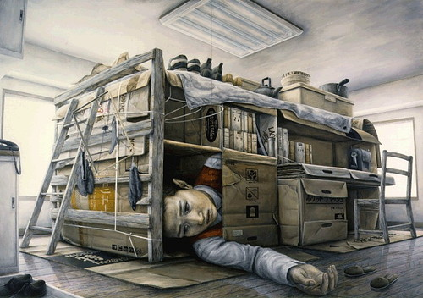
Tetsuya Ishida (Japanese, 1973-2005), "Untitled" 1998, Oil Painting, size not given

Slide 3
DESCRIBE: How does the artist create the illusion of form in this work with perspective and values? What type of perspective is used – where do you see tints and shades?
Write your answers with complete sentences that give specific details.

Slide 4
ANALYZE: How is repetition used in this work? Name at least three items that are repeated and where you see them in the work.
Write your answers with complete sentences that give specific details.

Slide 5
INTERPRET: Look at the proportions used through out this work. Compare and contrast the person with the other items in the painting. What is the artist trying to say?
Write your answers with complete sentences that give specific details.

Slide 6
JUDGE: How realistic are the items shown in this work (shoes, paper bags, clothing…)?
Write your answers with complete sentences that give specific details.

