Slide 1
Two point perspective books
A Headlong Pursuit
By Kevin Sloan

Slide 2
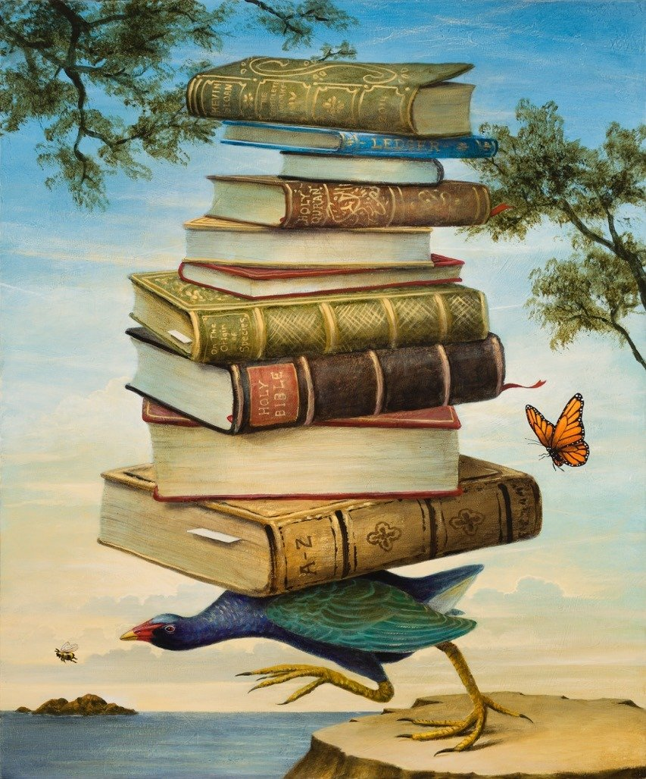
Kevin Sloan, American
A Headlong Pursuit
2014
Acrylic on Canvas
30” x 36”

Slide 3
DESCRIBE
Write three sentences- Describe what you see in the foreground, middle ground, and background in this painting. You need DETAILS
Remember to defend your answer using complete sentences.

Slide 4
ANALYZE the use of proportion in the three flying creatures in this painting
Remember to defend your answer using complete sentences.

Slide 5
INTERPRET
Why did the artist chose to use a bird to carry his books?
Remember to defend your answer using complete sentences.

Slide 6
JUDGE the artist drawing skills used to make this two point perspective painting.
Remember to defend your answer using complete sentences.

