Slide 1
Cut Layers
Project research steps

Slide 2
RESEARCH
Art work by Maud Vantours, French
Art work by Jen Stark, American, b. 1983
Art work by other artist you found

Slide 3
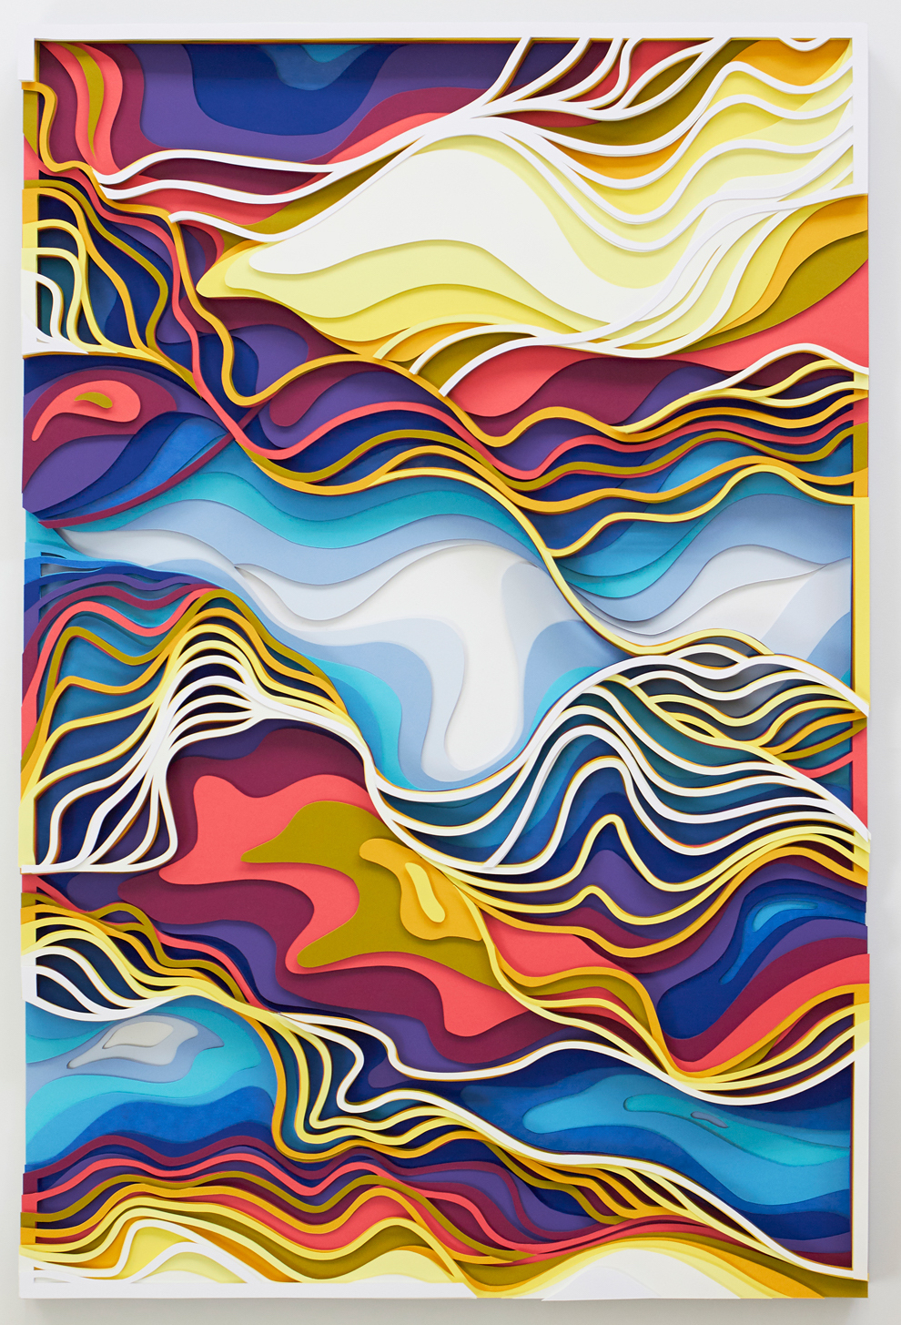
Research - Maud Vantours https://maudvantours.com
Bombay Sapphire
Layers of organic shapes are connected with curved lines

Slide 4
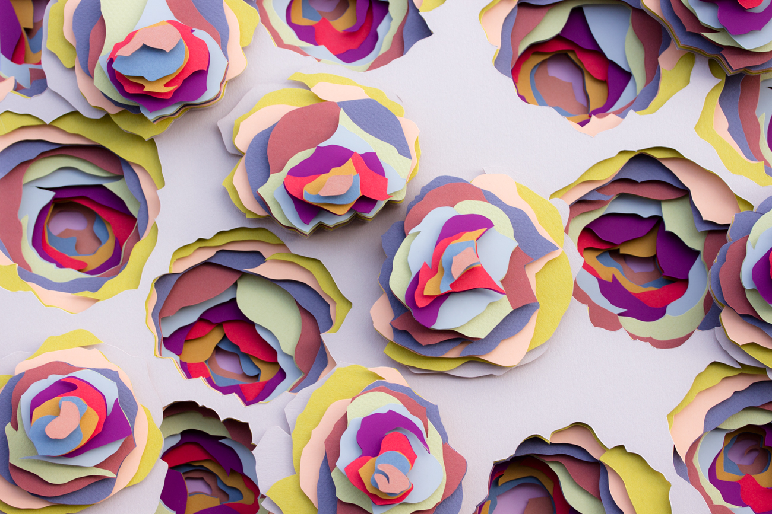
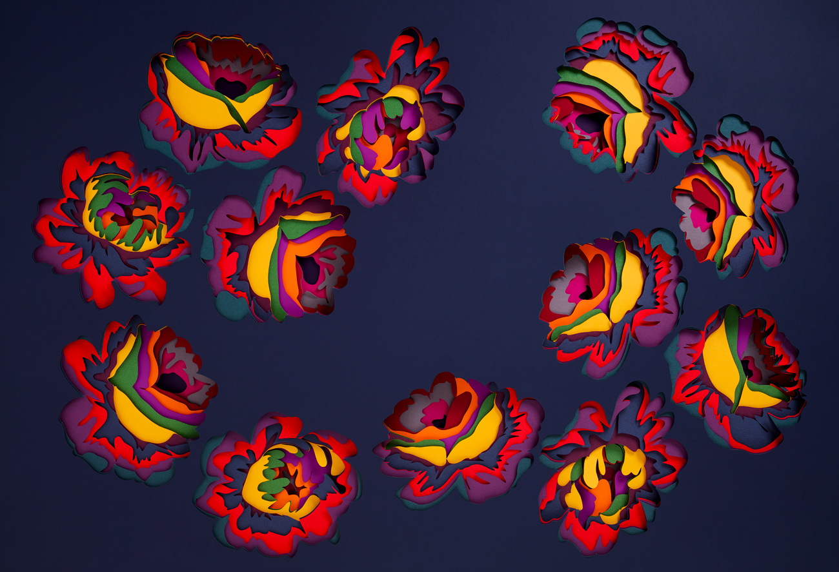
Maud Vantours Flora https://maudvantours.com
Notice the cut pieces from the piece were later stacked on top of the top cut layer.
How many layers of color do you see?

Slide 5
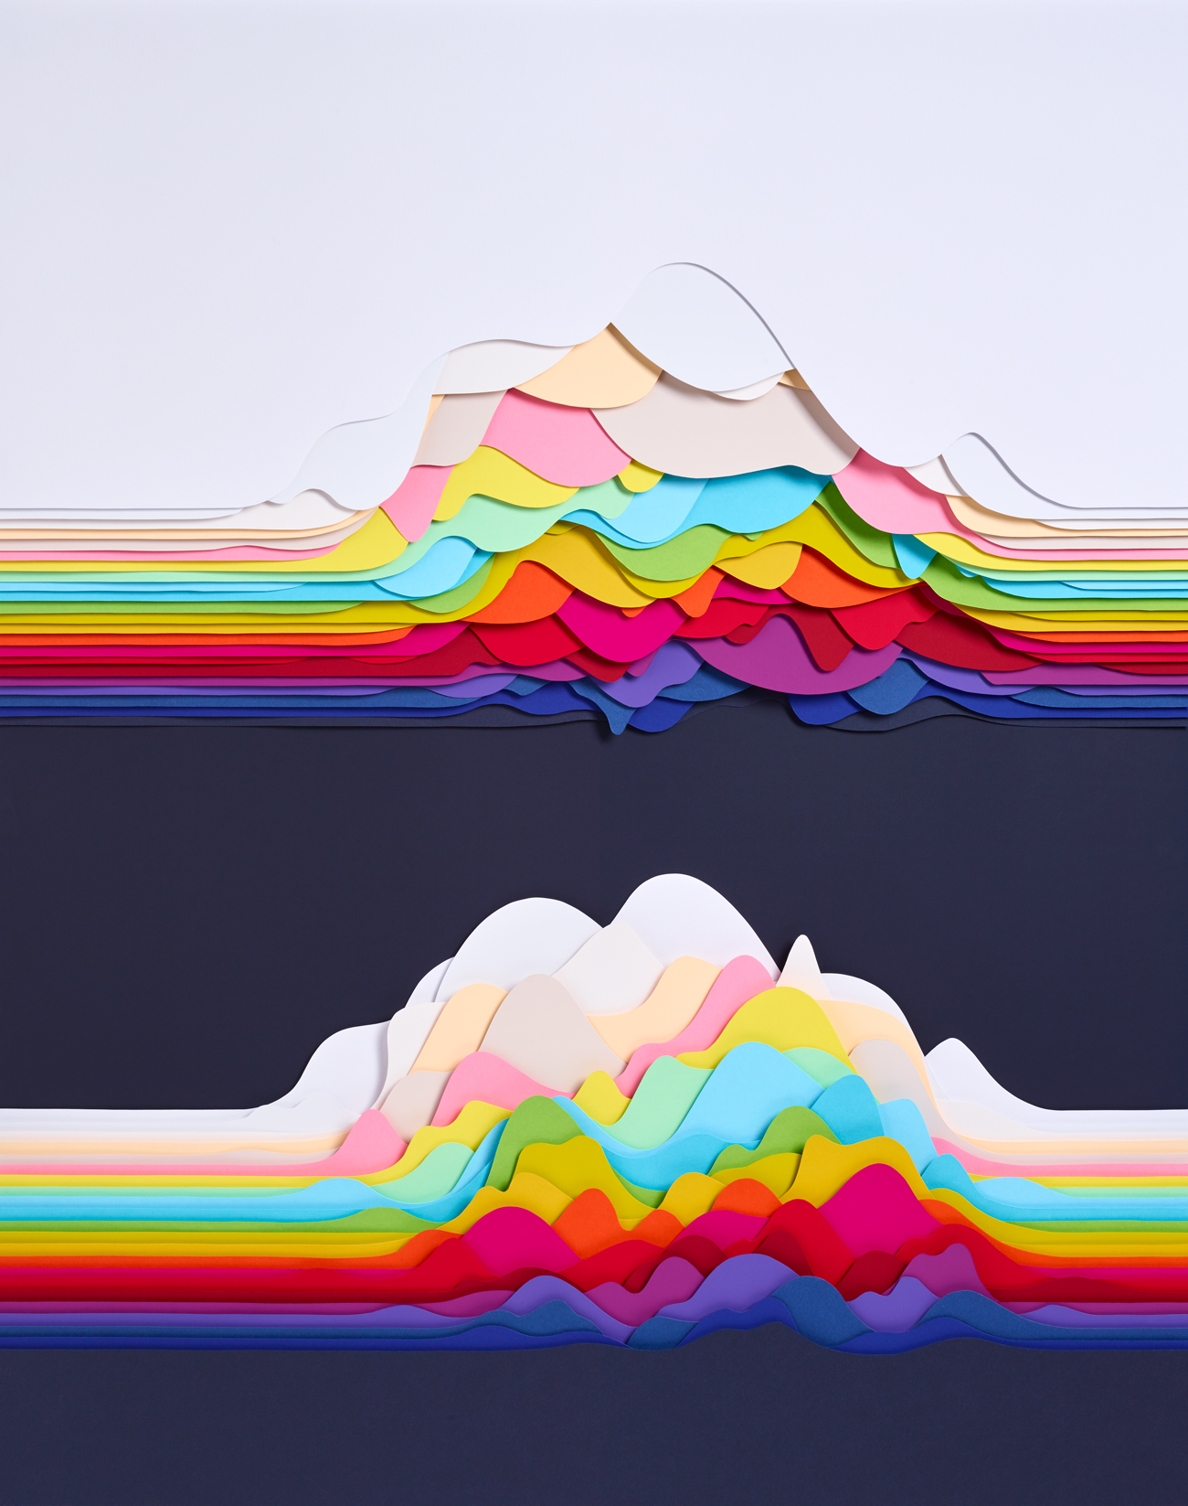
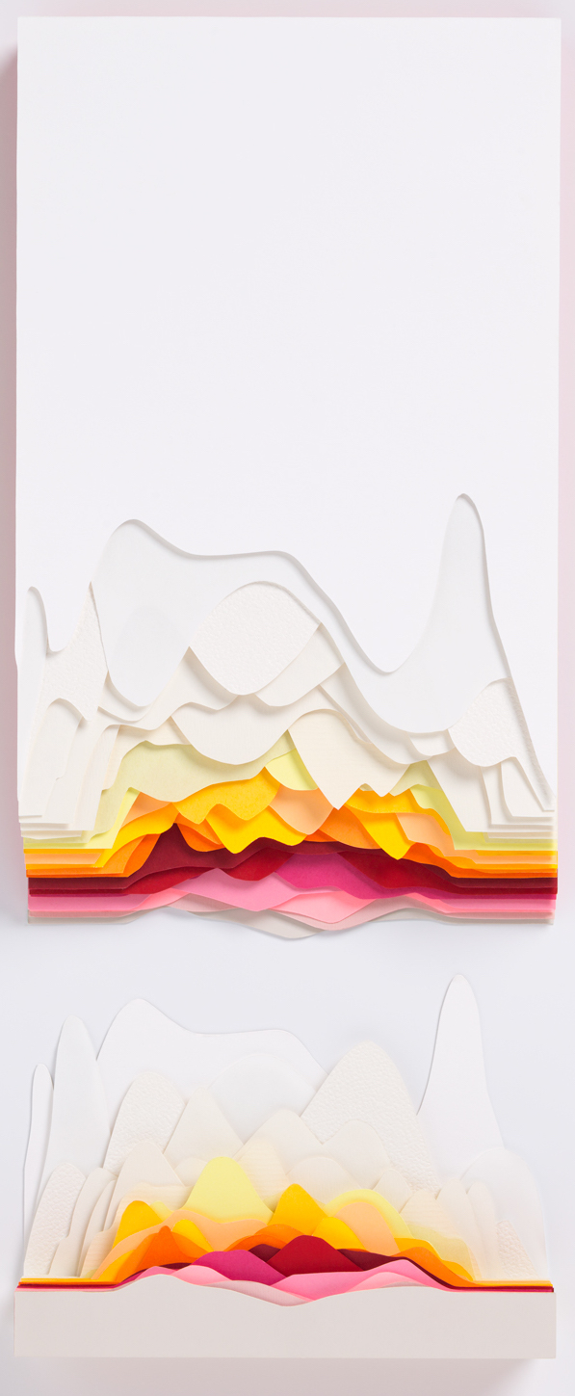
Maud Vantours Oscillations series https://maudvantours.com
Landscape sculptures.
Created by layers of flat paper that have been overlapped.
These pieces remind me of what you might see underground in a cave.

Slide 6
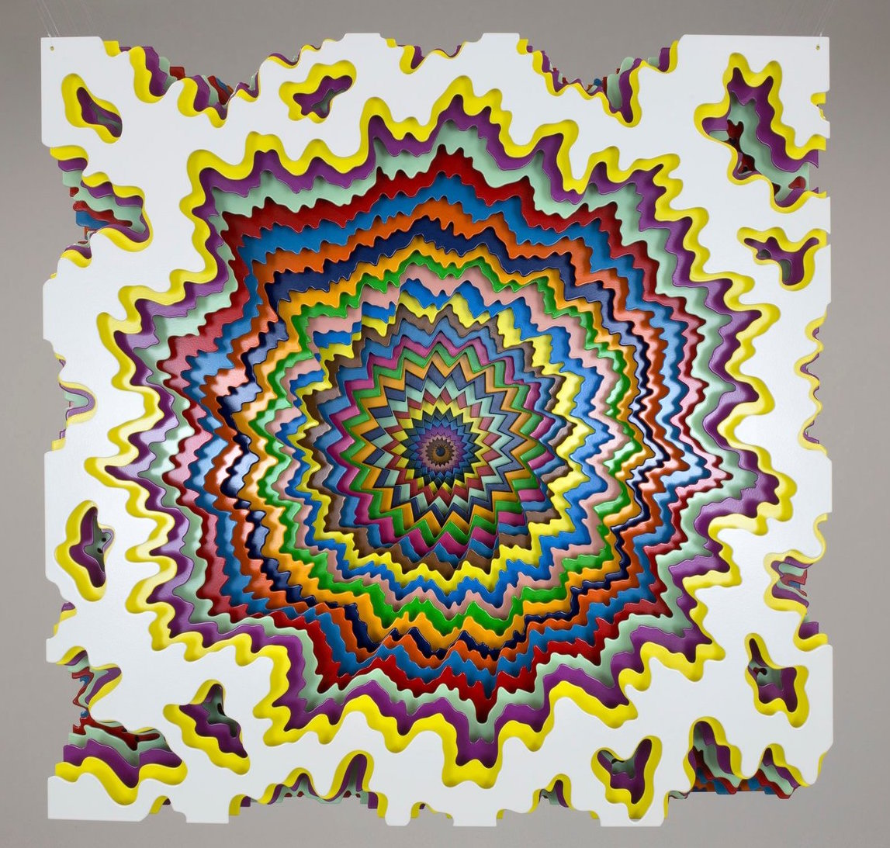
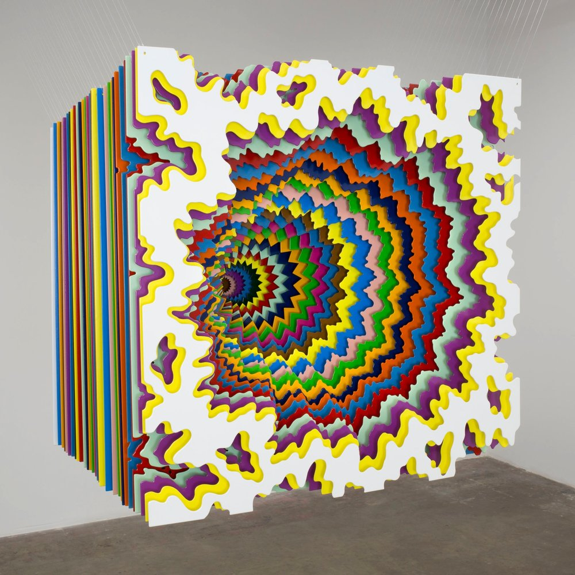
RESEARCH Jen Stark jenstark.com
30 Cubed
2019
powder coated aluminum and monofilament
30 x 30 x 30 in.
Notice how the free-form shape at the top changes as it descends into the center. Then the shape becomes more geometric.

Slide 7
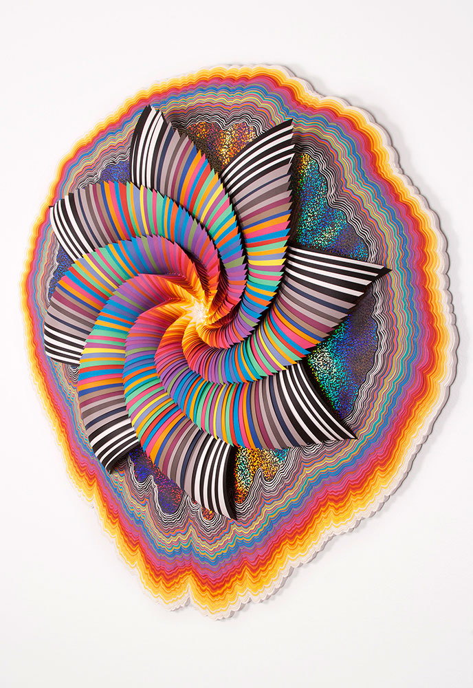
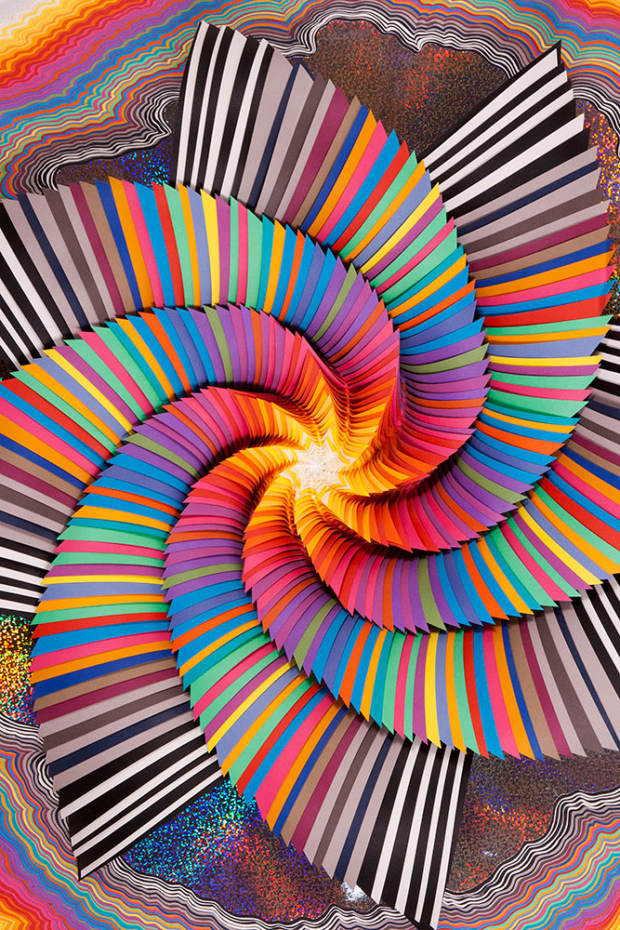
RESEARCH Jen Stark jenstark.com
Cosmagraphic
2014
acid-free paper, holographic paper, glue, wood, acrylic paint
34 x 37 x 4 in
Simple triangular cuts were used for the center spiral pieces, a repeating organic shapes were used for the base.

Slide 8
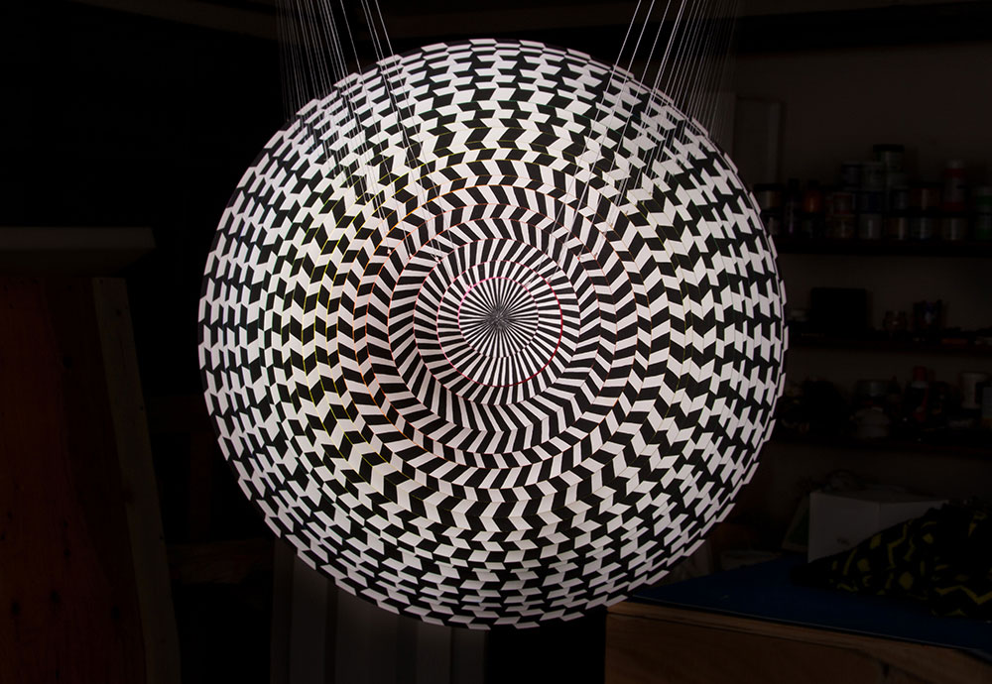
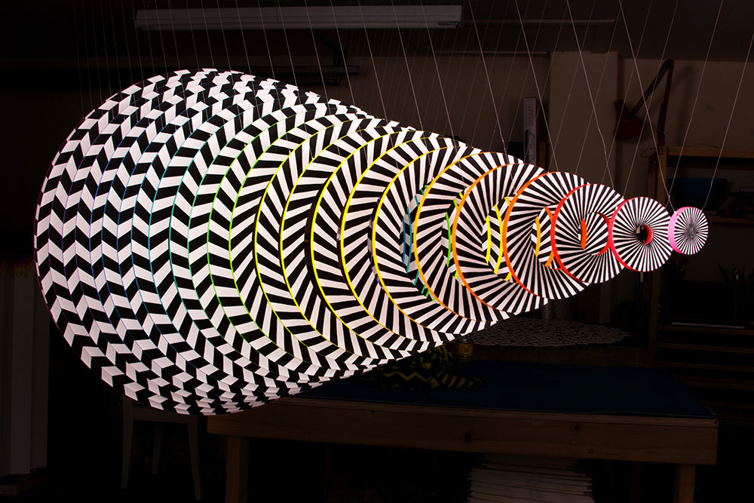
RESEARCH Jen Stark jenstark.com
Dimension
2013 PVC, acrylic paint, UV varnish, monofilament
25 x 25 x 50 in.
When looking from the end piece from the circle the work become more of an op art piece.

Slide 9
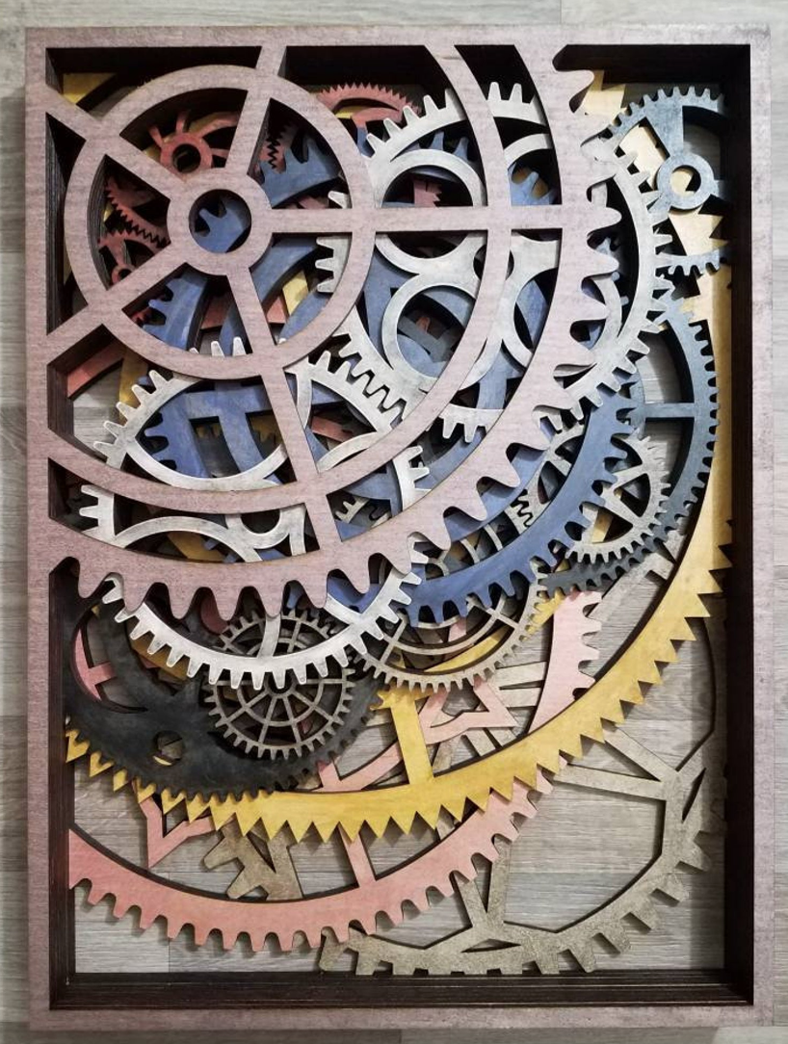
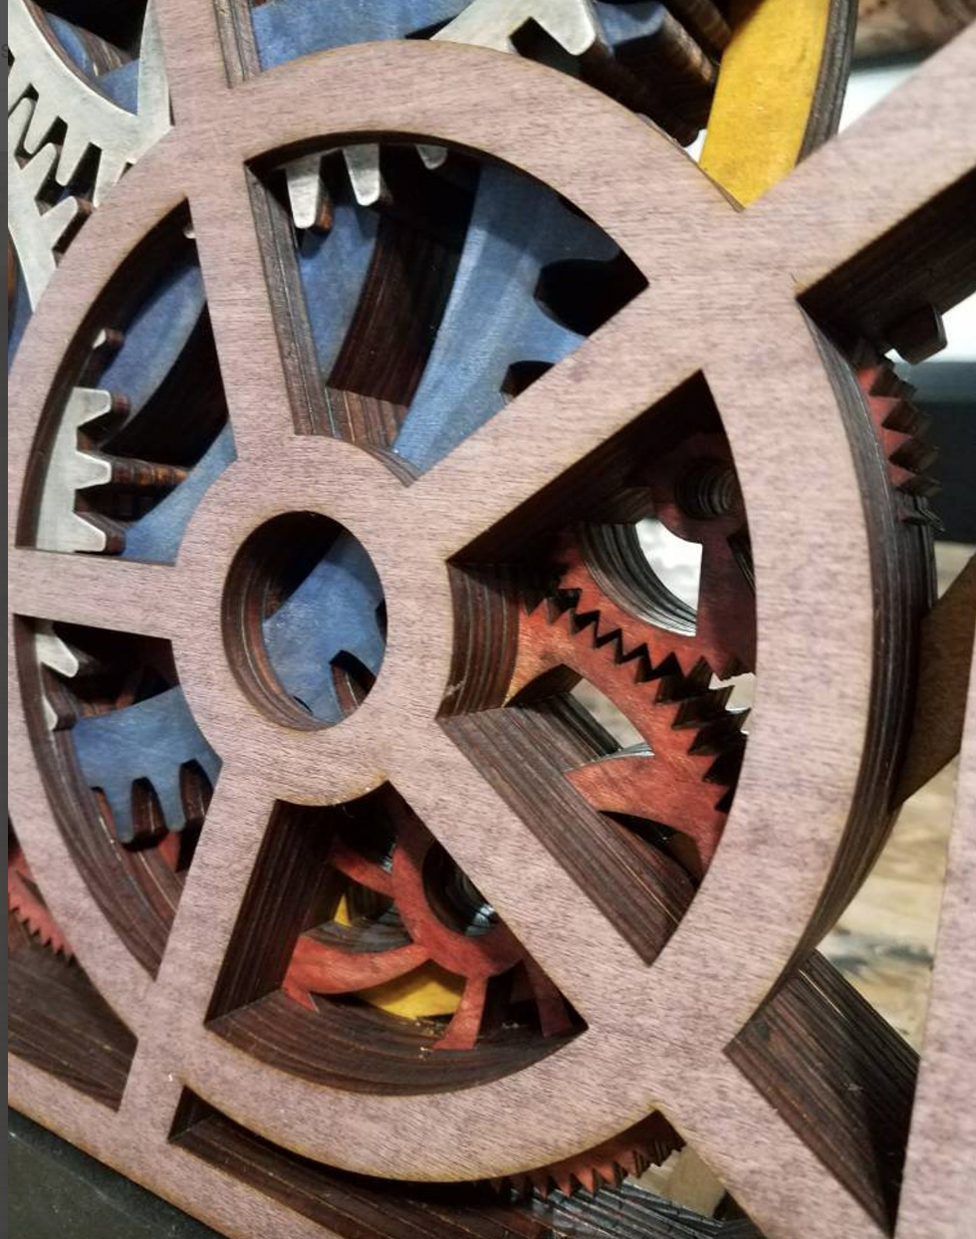
RESEARCH
Christopher Myles
"Mess of Gears”
wood, glue, stain, plywood
23.5” x 17.5” x 2”
https://www.etsy.com/listing/627933686/laser-cut-wall-art-wall-decor-wood?ref=landingpage_similar_listing_top-3
Having not a full circle is a possibility.

Slide 10
RESEARCH
Gear possibilities
Will need to draw these out to see which one would work.
https://www.etsy.com/listing/663662118/steampunk-gears-cogs-stencil-sku-ind0101?gpla=1&gao=1&&utm_source=google&utm_medium=cpc&utm_campaign=shopping_us_b-craft_supplies_and_tools-canvas_and_surfaces-stencils_templates_and_transfers-stencils&utm_custom1=a7f2547d-a0c5-4f94-8062-4ed97a4538d4&utm_content=go_2063077565_76452862975_367965824328_pla-297783379911_c__663662118&utm_custom2=2063077565&gclid=EAIaIQobChMIht2V1tr96wIVAdvACh1-qQzoEAQYBSABEgK2_vD_BwE

