Slide 1
Cut Layers
Project Exhibition step

Slide 2
Exhibition steps
Photograph your finished Paper Layer artwork
Write a full credit line for your work
Write an artist statement for your work.

Slide 3
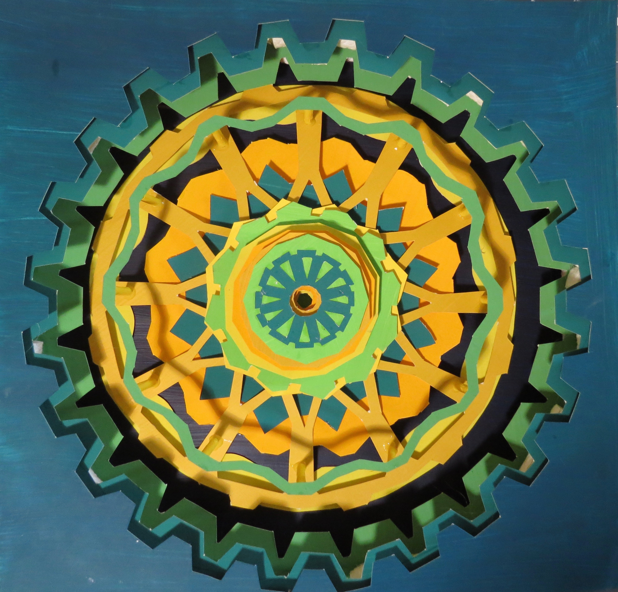
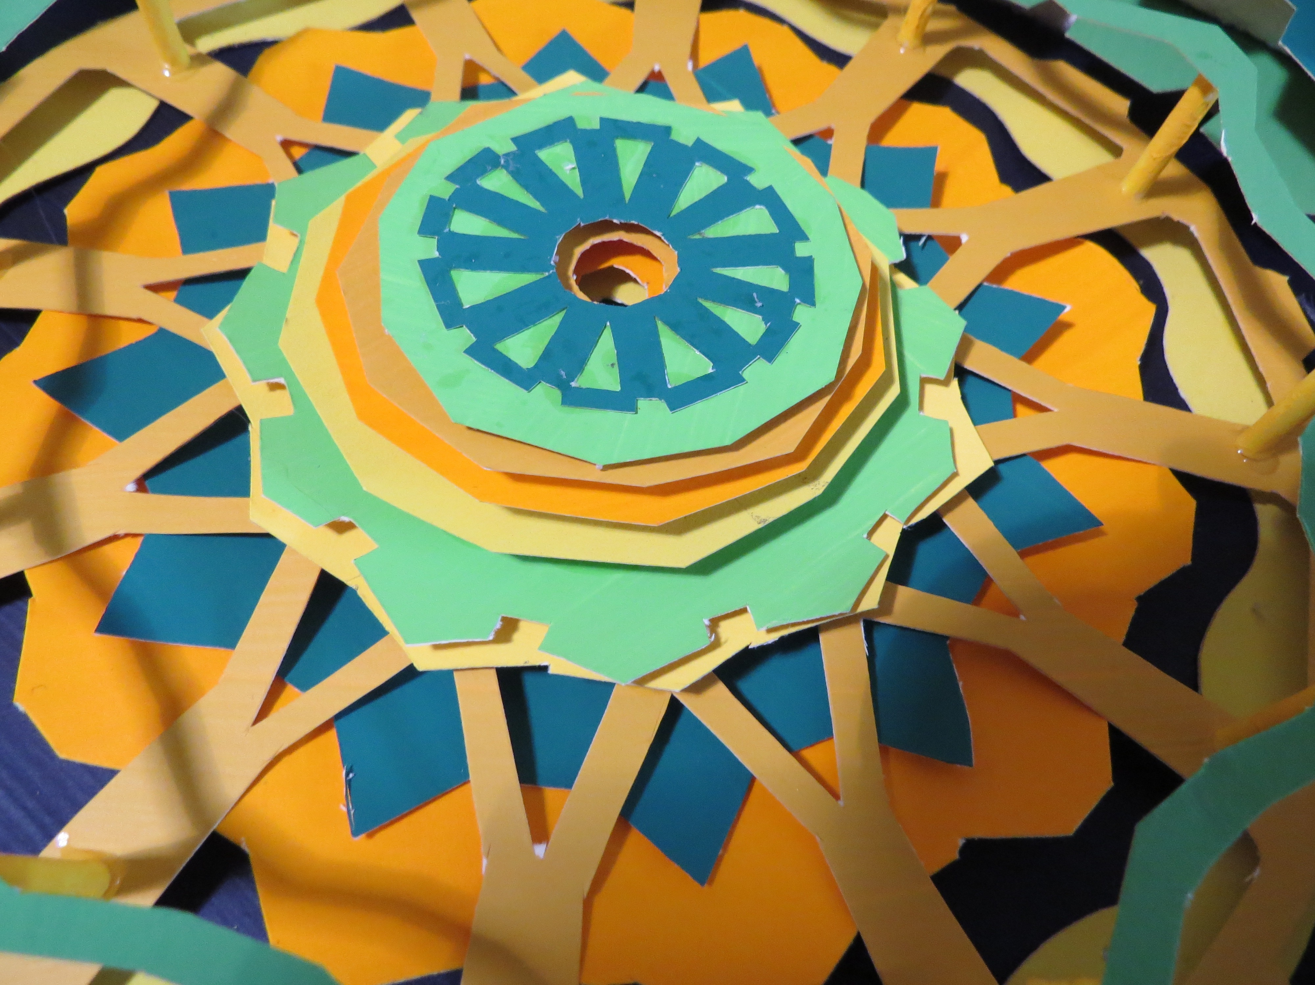
EXHIBITION
Top View
Angled views

Slide 4
EXHIBITION
Patricia Beach, American
Wolfson High Art teacher
Dodecagon Gears
2020
tag board paper, acrylic paint, glue, straws, foam core base.
12 x 12 x 1.75 in

Slide 5
EXHIBITION Artist statement
Looking at Dodecagon Gears you can see a series of ten cut layers of painted paper. The top three layers are gears with twenty-four points. The center of the low-relief sculpture is made of various dodecagons.
The shapes used for this art piece were all geometric while some of the lines were curved. The color scheme is analagous and the type of balance is radial. Repetition is used with the designs in the gears and in the center layers. The cut out triangles in the center dodecagon brings your attention to the center of the artwork. If you look closer, there are more cut shapes drawing the eyes down the center.
Interpretation is left up to the viewer. The artist intent was to bring in memories of Dr. Who, Hugo, and other art that has used clock parts.
The original plan for the art was changed due to the cutting through the paint layers. Some of the cuts were not cut sharply so you can see some of the tag board. Future layer paper projects would be better using #140 watercolor paper.

