Slide 1
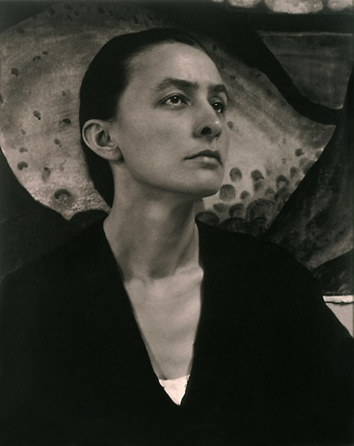
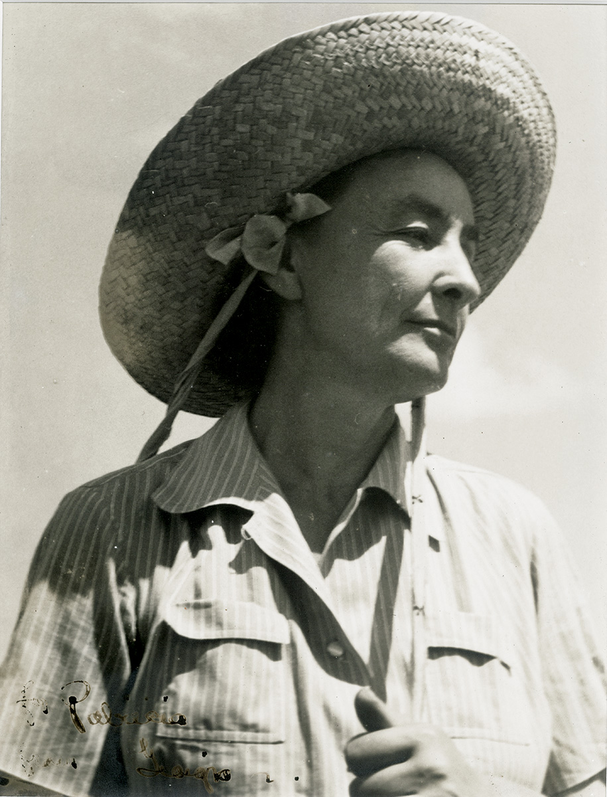
Georgia O’Keeffe
1887 - 1986
American
1918/21
1980’s
1939

Slide 2
Bella Donna
1939
Oil on canvas
36 1/4 x 30 1/8 in.

Slide 3
White Bird of Paradise
1939
Oil on canvas
19 x 16”
https://collections.okeeffemuseum.org/object/1148/

Slide 4
Calla Lilies
1924
Oil on canvas,
16 x 12 in.

Slide 5
Two Calla Lily on Pink
1928
Oil on canvas
40 × 30 inches (101.6 × 76.2 cm)

Slide 6
Light Iris
1924
Oil on canvas
40 x 30”

Slide 7
White Iris
1930
Oil on canvas
40 x 30”

Slide 8
Jimson Weed/White Flower No. 1
1932 Oil paint on canvas 48 x 40 inches
https://www.tate.org.uk/press/press-releases/georgia-okeeffe-0

Slide 9
Purple Leaves
1922
Oil on canvas
9 x 12 x 3/8 inches

Slide 10
Jack-in-the-Pulpit No. 3
1930
Oil on canvas
40 x 30”

Slide 11
Jack-in-the-Pulpit No. 5
1930
Oil on canvas
40 x 30”

Slide 12
Yellow Cactus
1929
Oil on canvas
30 x 42”

Slide 13
An Orchid
1941
Pastel on paper
27 5/8 x 21 ¾”

Slide 14
Petunias
1925
Oil on Hardboard
18 x 30”

Slide 15
YELLOW JONQUILS #3
1936
oil on canvas
30¼ x 40¼ inches

Slide 16
Jonquils 1
1936
Oil on canvas
16 by 22 in.

Slide 17
Blue Morning Glories
1935

Slide 18
Narcissa’s Last Orchid
1941
Pastel
54.5 x 69.1 cm.

Slide 19
Series I—No. 2
1918 Oil on board 20 × 17 in. (50.8 × 43.18 cm)

Slide 20
Poppies
1950 Oil on canvas 36 × 30 in. (91.44 × 76.2 cm)

Slide 21
Hibiscus With Plumeria
1939
40 x 30”
Oil on canvas

Slide 22
Cos Cob
1926
Oil on canvas
16" x 12 in.

Slide 23
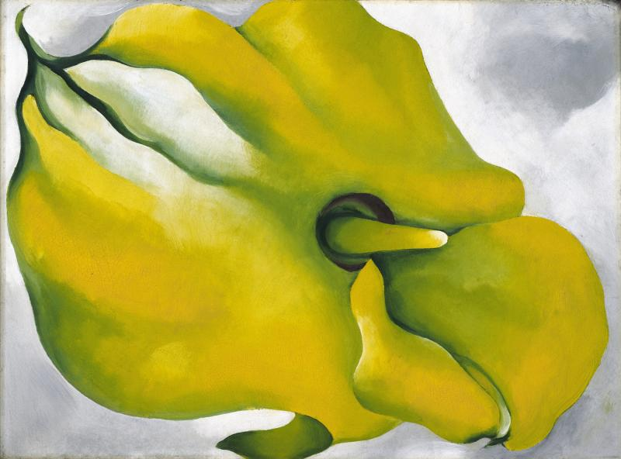
Yellow Calla
1926
oil on fiberboard
9 x 12 3/4 in. (22.9 x 32.4 cm

Slide 24
Oriental Poppies
1927
Oil on canvas

Slide 25
Poppy 1927
Oil on canvas
30 x 36”

Slide 26
Jimson Weed
1936-37
oil on linen
70 x 83 1/2 in.

Slide 27
Blue Flower
1918
Pastel on paper mounted to cardboard
20 x 16 in.

Slide 28
Yellow Sweet Pea
1925
Pastel on paperboard 26 1/2 by 19 3/8 in.

Slide 29
Petunia, No. 2
1924
Oil on canvas
76.2cm by 91.44cm

Slide 30
Petunia II
1924
Oil on canvas
36 1/16 x 30 1/8 inches

Slide 31
Petunia
1925
oil on canvas
11 x 14.5”

Slide 32
Squash Blossom
1925
oil on board
18 x 13½ in.

Slide 33
White Rose with Larkspur No. 2
1927
Oil on Canvas
101.6 x 76.2 cm (40 x 30 in.)

Slide 34
Oak Leaves, Pink and Gray
1929 Oil on canvas
33 ⅛ x 18 inches

Slide 35
Green Oak Leaves
1923
Oil on Canvas
80 x 62 cm (31.5 x 24.4”)

