Slide 1
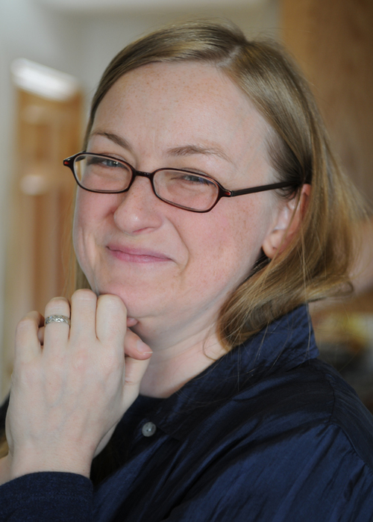
Jo Bradney
Passion (purple pencil stub)
Art Criticism

Slide 2
Jo Bradney, British
Passion
2014
Charcoal and pastel drawing
13” x 11”
“The very stubby end of my favorite purple color pencil Harold loved his purple crayon too – oh the places it took him…”
http://www.bradney.com/carbon-footprints/purple-crayon-heart-still-life-charcoal-drawing

Slide 3
DESCRIBE
What do you see in the foreground, middle ground, and background in this artwork by Jo Bradney?
REMEMBER: Write your answers with complete sentences that give specific details.

Slide 4
ANALYZE
What color scheme was used for this drawing?
REMEMBER: Write your answers with complete sentences that give specific details.

Slide 5
INTERPRET
Why did the artist just show a pencil stub with the pencil shaving?
REMEMBER: Write your answers with complete sentences that give specific details.

Slide 6
JUDGE
How well does that artist use values in this drawing?
REMEMBER: Write your answers with complete sentences that give specific details.

