Slide 1
Truncated Icosahedron
Nik Savvas
Pre-IB 2 warm-up

Slide 2
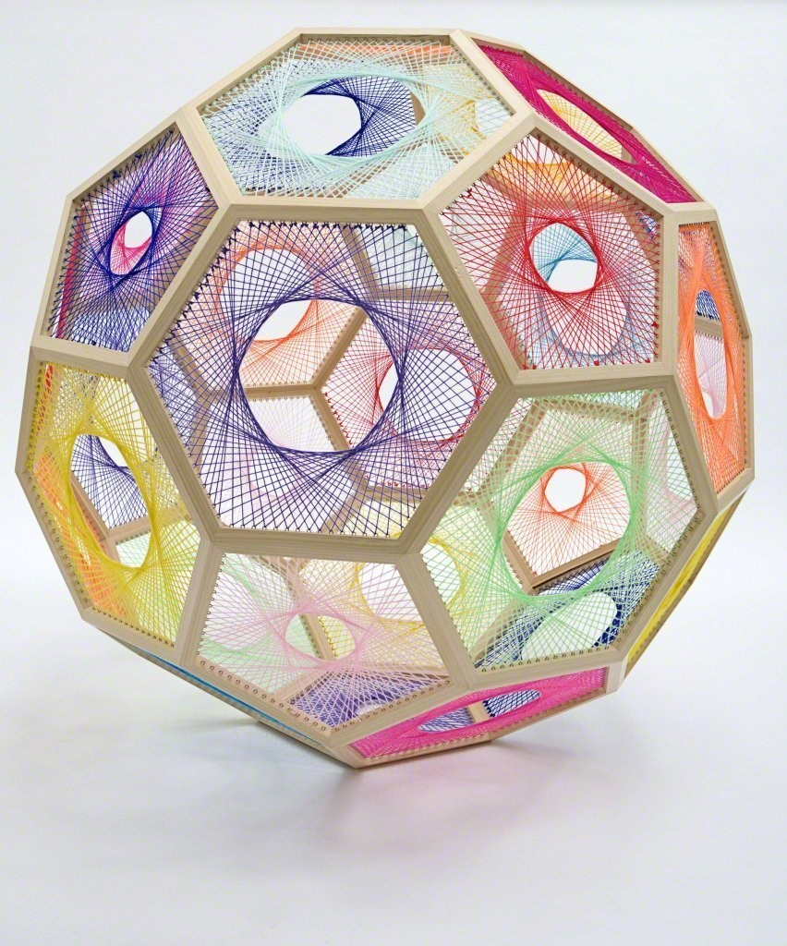
Nike Savvas, Australian, b.1964
Sliding Ladder: Truncated Icosahedron
2014
Wood, wool and steel
35 2/5 × 35 2/5 × 35 2/5 in (90 × 90 × 90 cm)
https://www.artsy.net/artwork/nike-savvas-sliding-ladder-truncated-icosahedron-small

Slide 3
DESCRIBE the use of shape and line in this artwork.
Remember to support your answer using complete sentences.

Slide 4
ANALYZE the repetition and variety in this artwork
Remember to support your answer using complete sentences.

Slide 5
INTERPRETE why the artist used the the colors selected for this artwork.
Remember to support your answer using complete sentences.

Slide 6
JUDGE how well the artist was able to control the media used for this artwork.
Remember to support your answer using complete sentences.

