Slide 1
Golden mean or Fibonacci Spiral
Warm-up

Slide 2
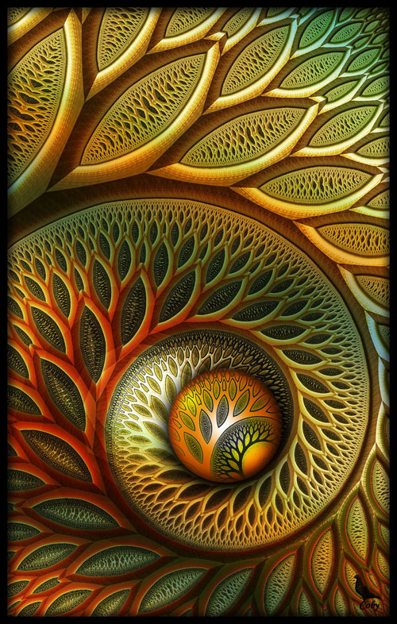
Coby01, Dutch
Flynn
December 2009
size not given
Digital Art/ Fractal Art made using the computer software “ultrafractal”
http://coby01.deviantart.com/gallery/

Slide 3
DESCRIBE
Write three sentences that describes what you see in this composition. Each sentence must describe an element of art that was used.

Slide 4
ANALYZE
How did the artist use variety and proportion in this artwork?
Remember to support your answer using complete sentences.

Slide 5
INTERPRET
What is the artist saying about nature in this artwork?
Remember to support your answer using complete sentences.

Slide 6
JUDGE
The craftsmanship skills of the artist. How well did the artist use the “golden mean/
fibonacci spiral” in this
artwork?
Remember to support your answer using complete sentences.

