Slide 1
Fibonacci Art/ Golden Mean
Project Instruction

Slide 2
Step 1
Log into your computer
Open Microsoft Word
Create a new word document
Save your word document using the following
lastname_firstname_classperiod_fibonacciplan1
Make sure you save at the end of each step!

Slide 3
Step 2
Full Name, Class period
Go to Layout
Set your Margins to “Narrow”
Put your full name and class period on the first line.
Go to Insert and select shapes.
Put in a rectangular shape.
  Format shape with Shape Fill as none.
  Format shape with a black outline.
  Format size to be 3” x 3”
  Arrange- “In Front of Text”

Slide 4
Step 3
Full Name, Class period
Go to Insert and select shapes.
Put in a black free form line.
    Your line needs to go from one corner to its diagonal corner. The line needs to be just slightly just inside the corners so that you can group the line and the square together.
    Add one to three shapes on one side of the line
    Add additional shapes to the other side of the line.
    Now you must group all of the items you have drawn. Hold down the Shift key, click on each item, Select format shape, and Group all together.
    Make sure your group square is now 3” x 3”.
Copy your group drawing.

Slide 5
Step 4
Paste the copied square onto your page 4 times so that you have 5 squares.
Shape format two of the squares so that they are 1” x 1”
Shape format one to be 2” x 2”
Shape format one to be 5”x5”

Slide 6
Step 5
Put your squares together to form a rectangle.
Select individual square and rotate as needed so that your free form lines connect and create a spiral direction.
Group all of your squares to form your final rectangle.
Format this group to be a 5” x 8” rectangle.
Rotate the rectangle so that it is in the center of your paper.
Save your document and then print it out.

Slide 7
Step 6
Copy and past your plan
Create a new document and paste in your plan
Format your shape to be 2.5” x 4”.
Copy and paste this shape so that you have 4 of your plans in this document.
Save as plan2
ONE EXAMPLE OF A POSSIBLE ARRANGEMENT

Slide 8
ANOTHER EXAMPLE OF A POSSIBLE ARRANGEMENT USING THE SAME PLAN

Slide 9
ANOTHER EXAMPLE OF A POSSIBLE ARRANGEMENT USING THE SAME PLAN

Slide 10
Step 7
Using your “H” pencil, trace your plan onto watercolor paper 4 times.
Add a boarder using shapes that you had in your plan to go around your arranged plan so that you fill in the entire 18x24” paper.
ONE EXAMPLE OF A POSSIBLE ARRANGEMENT

Slide 11
Step 8
LIGHTLY color in using watercolor pencils.
Add water to your drawing.
Add more layers of colors as needed to have tints and shades.
ONE EXAMPLE OF A POSSIBLE ARRANGEMENT

Slide 12
Student artwork
The following slides show Fibonacci art projects that were done by Wolfson High students

Slide 13
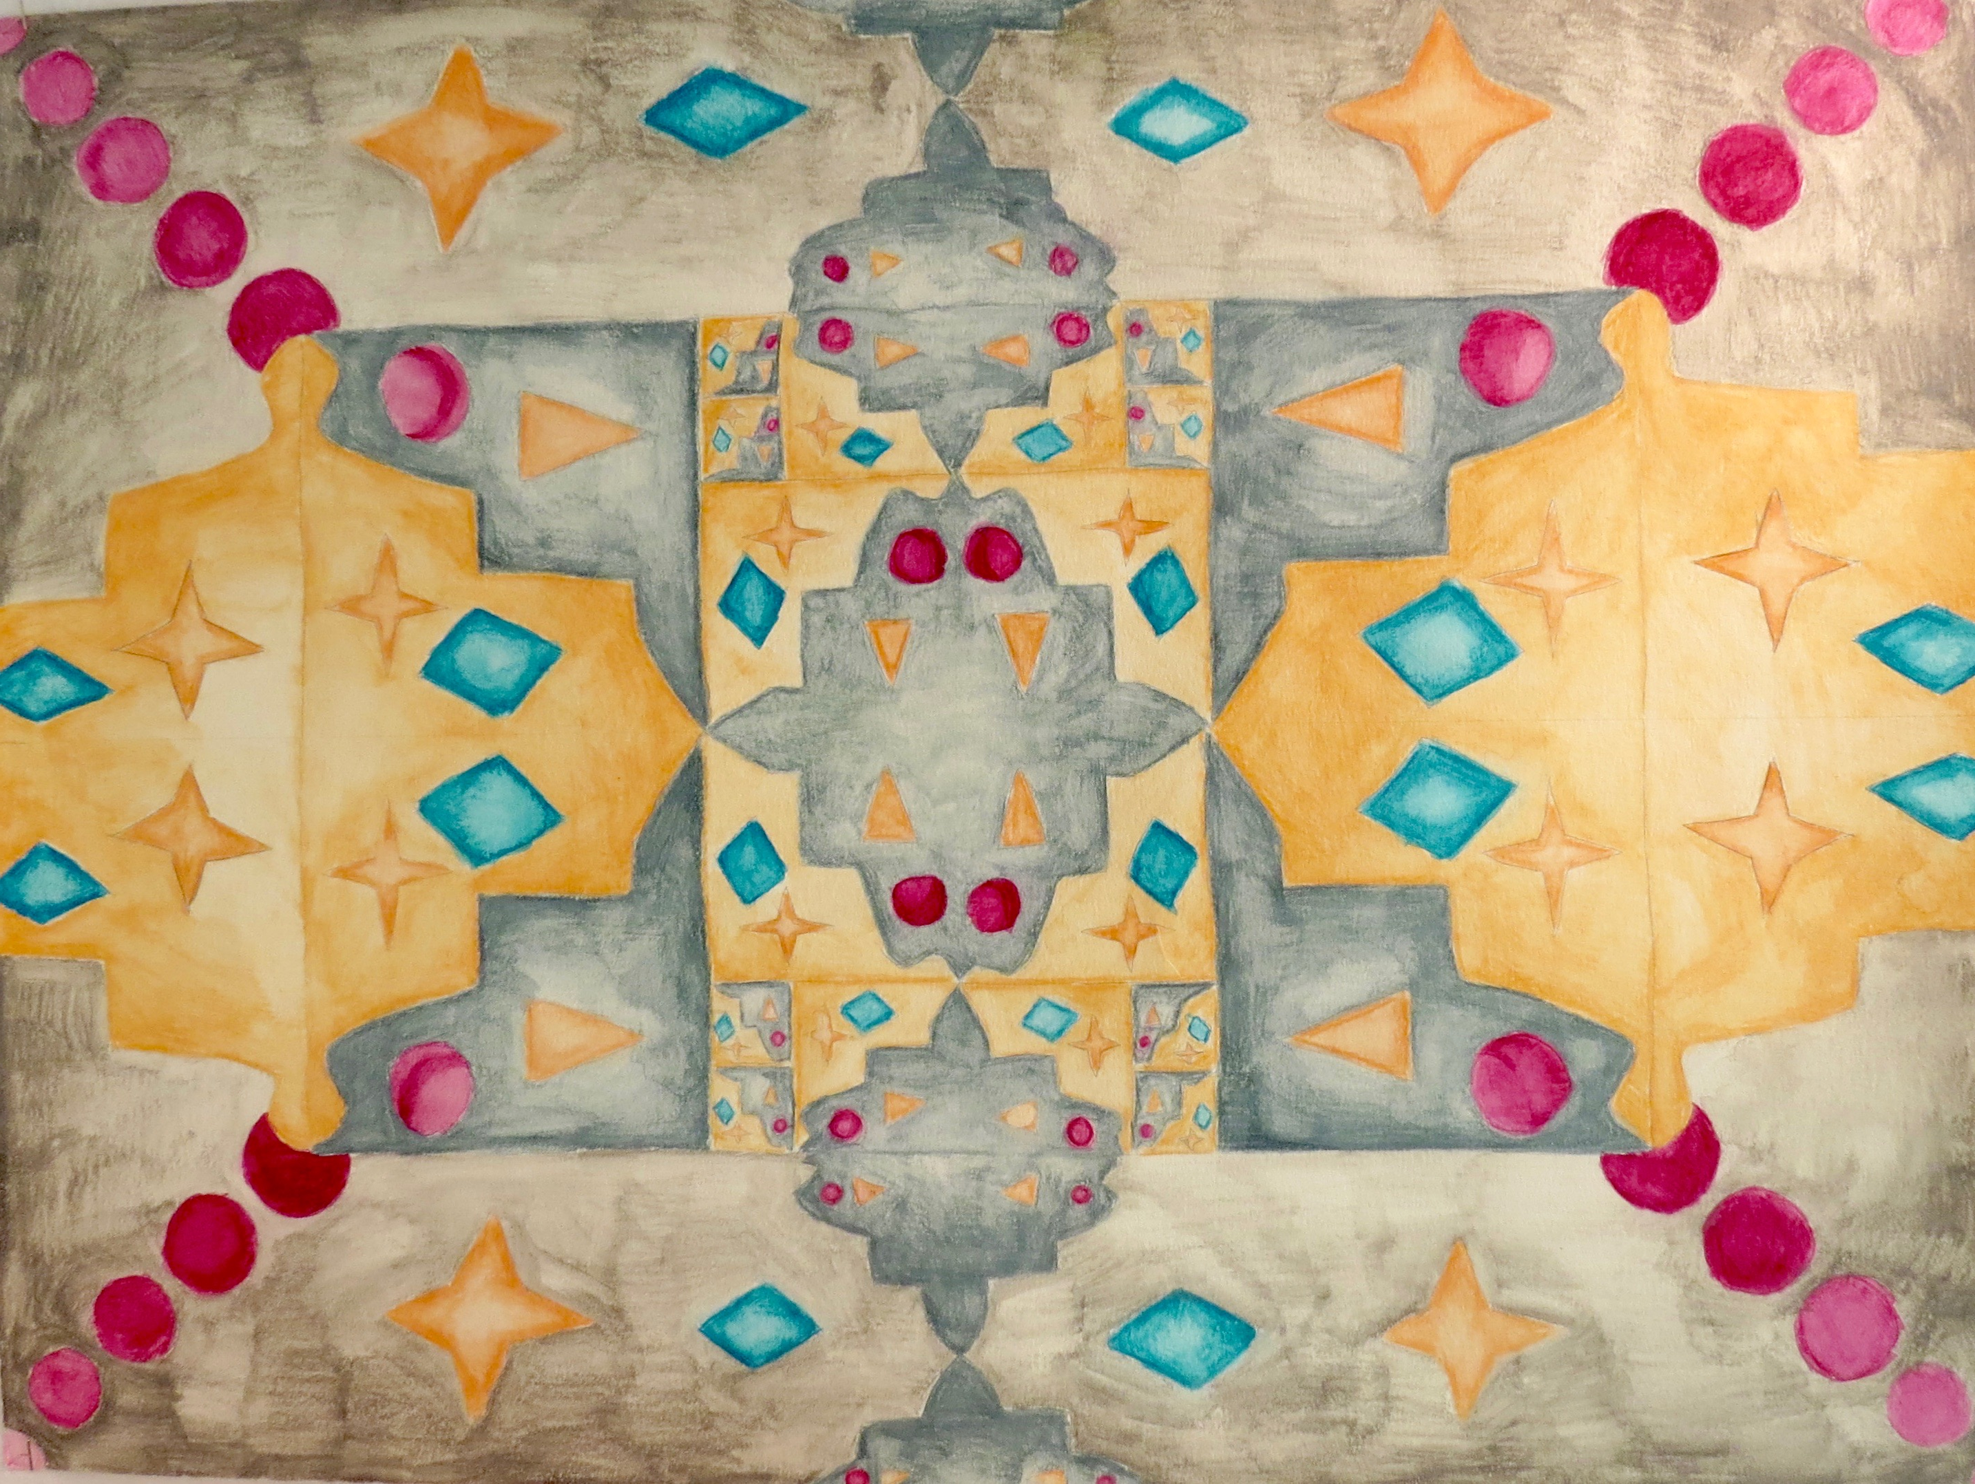
Wolfson High student work 2018-19

Slide 14
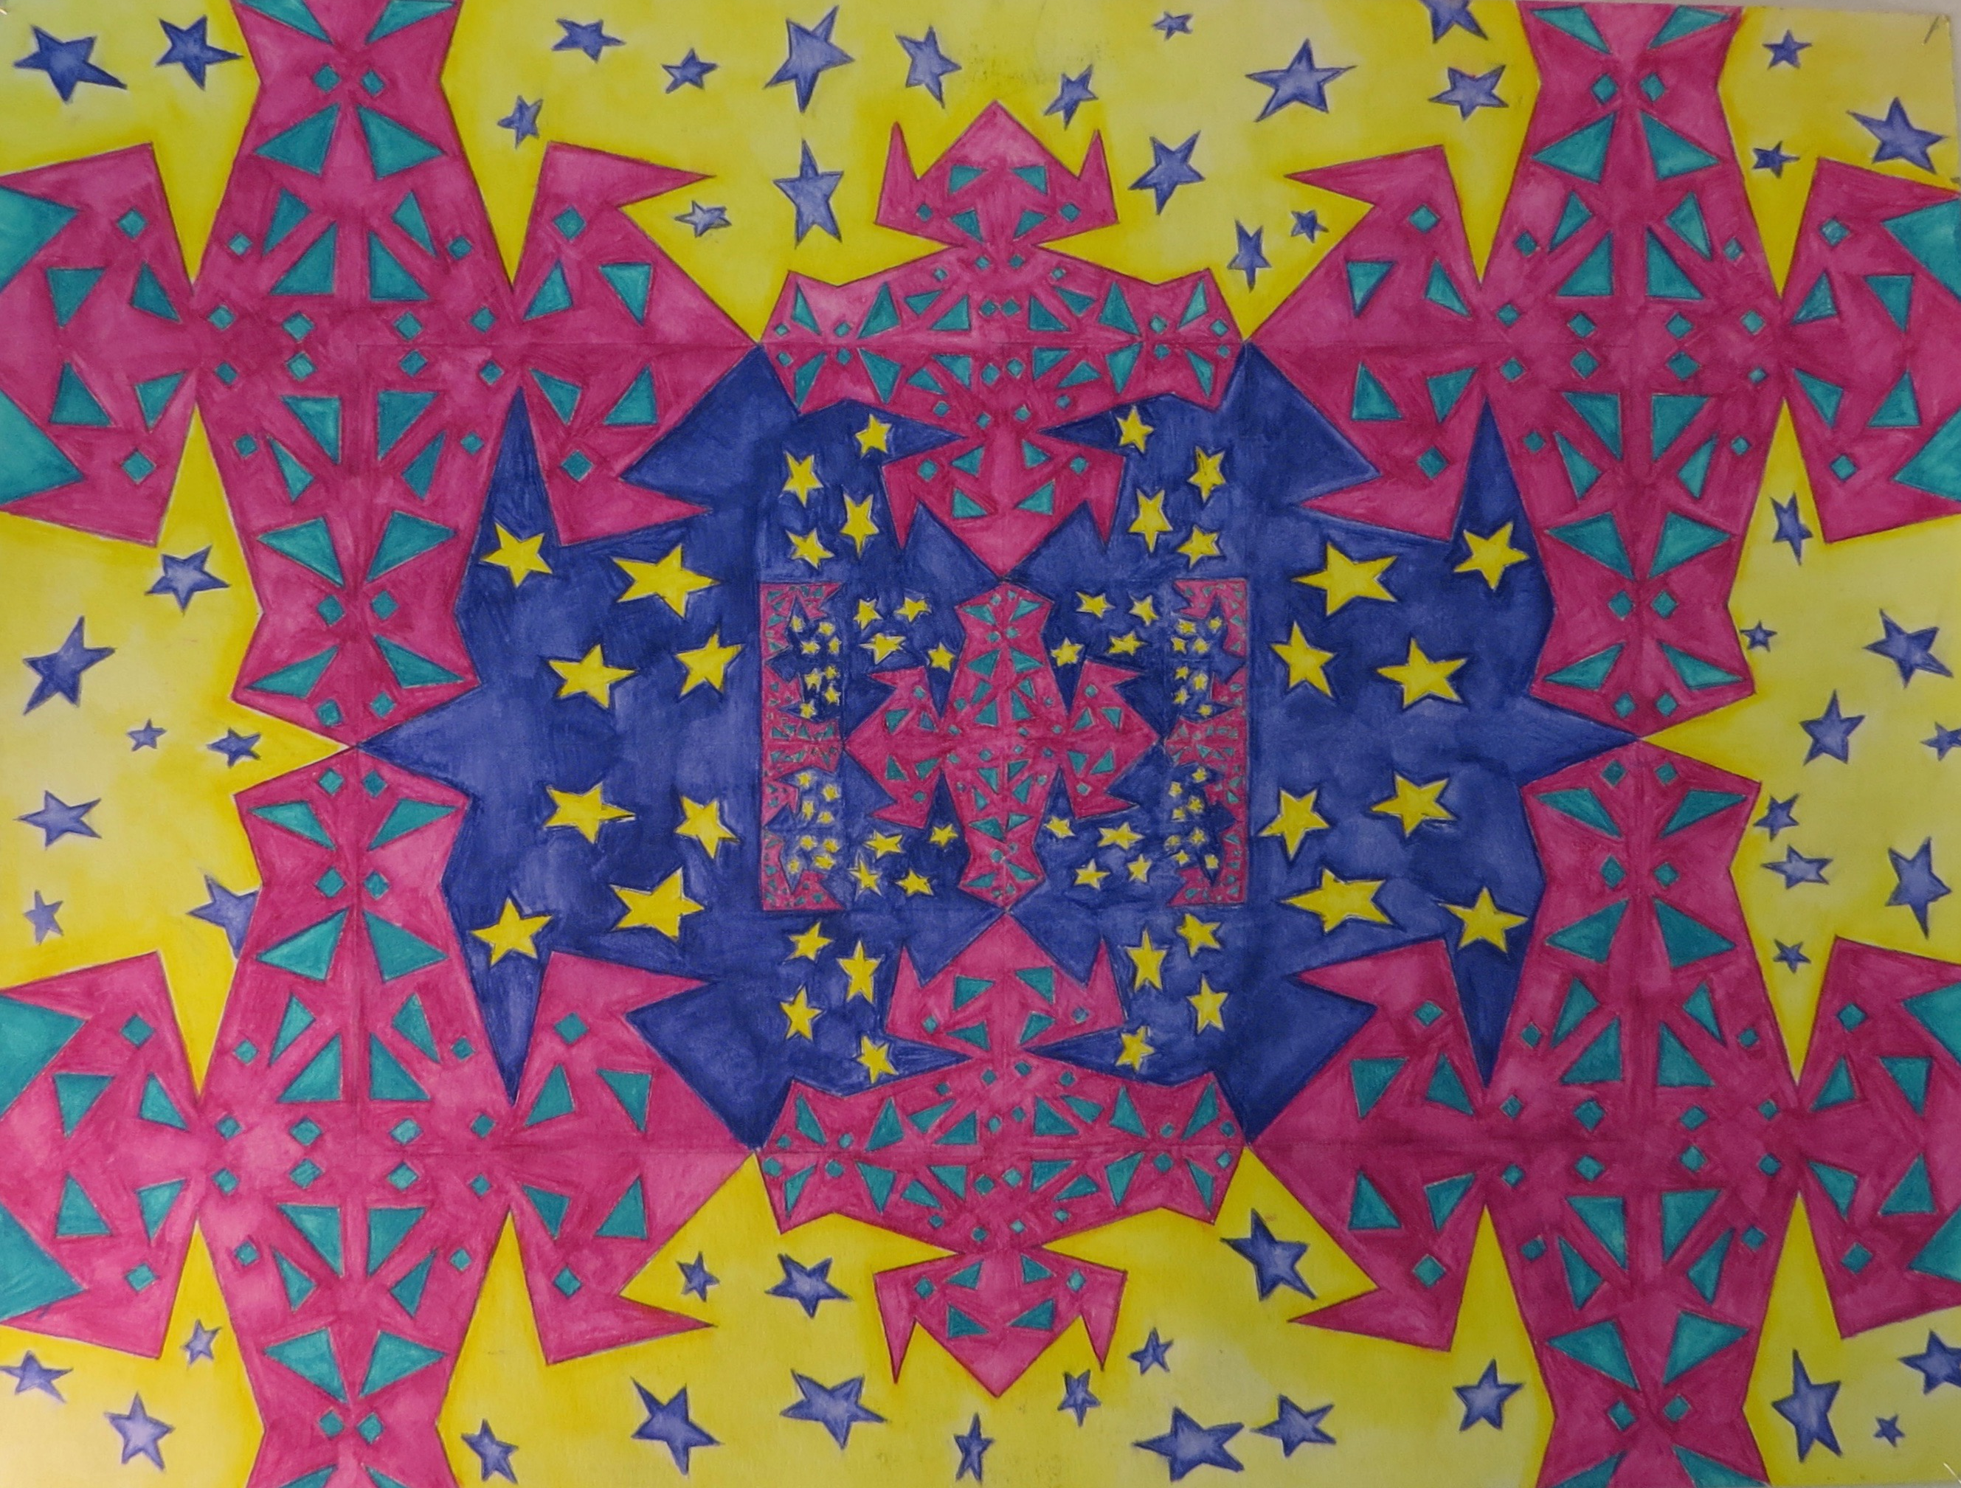
Wolfson High student work 2018-19

Slide 15
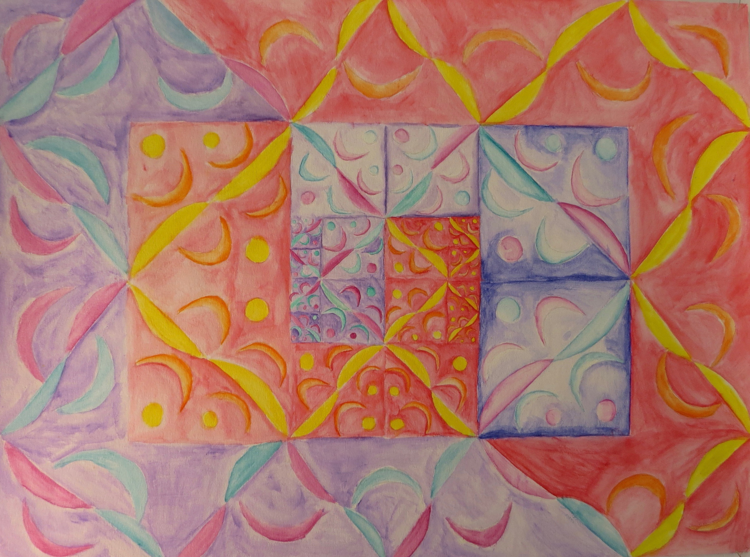
Wolfson High student work 2018-19

Slide 16
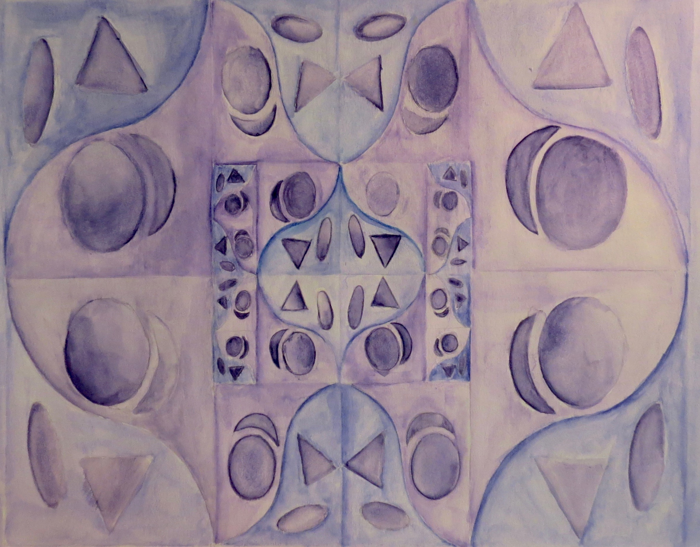
Wolfson High student work 2018-19

Slide 17
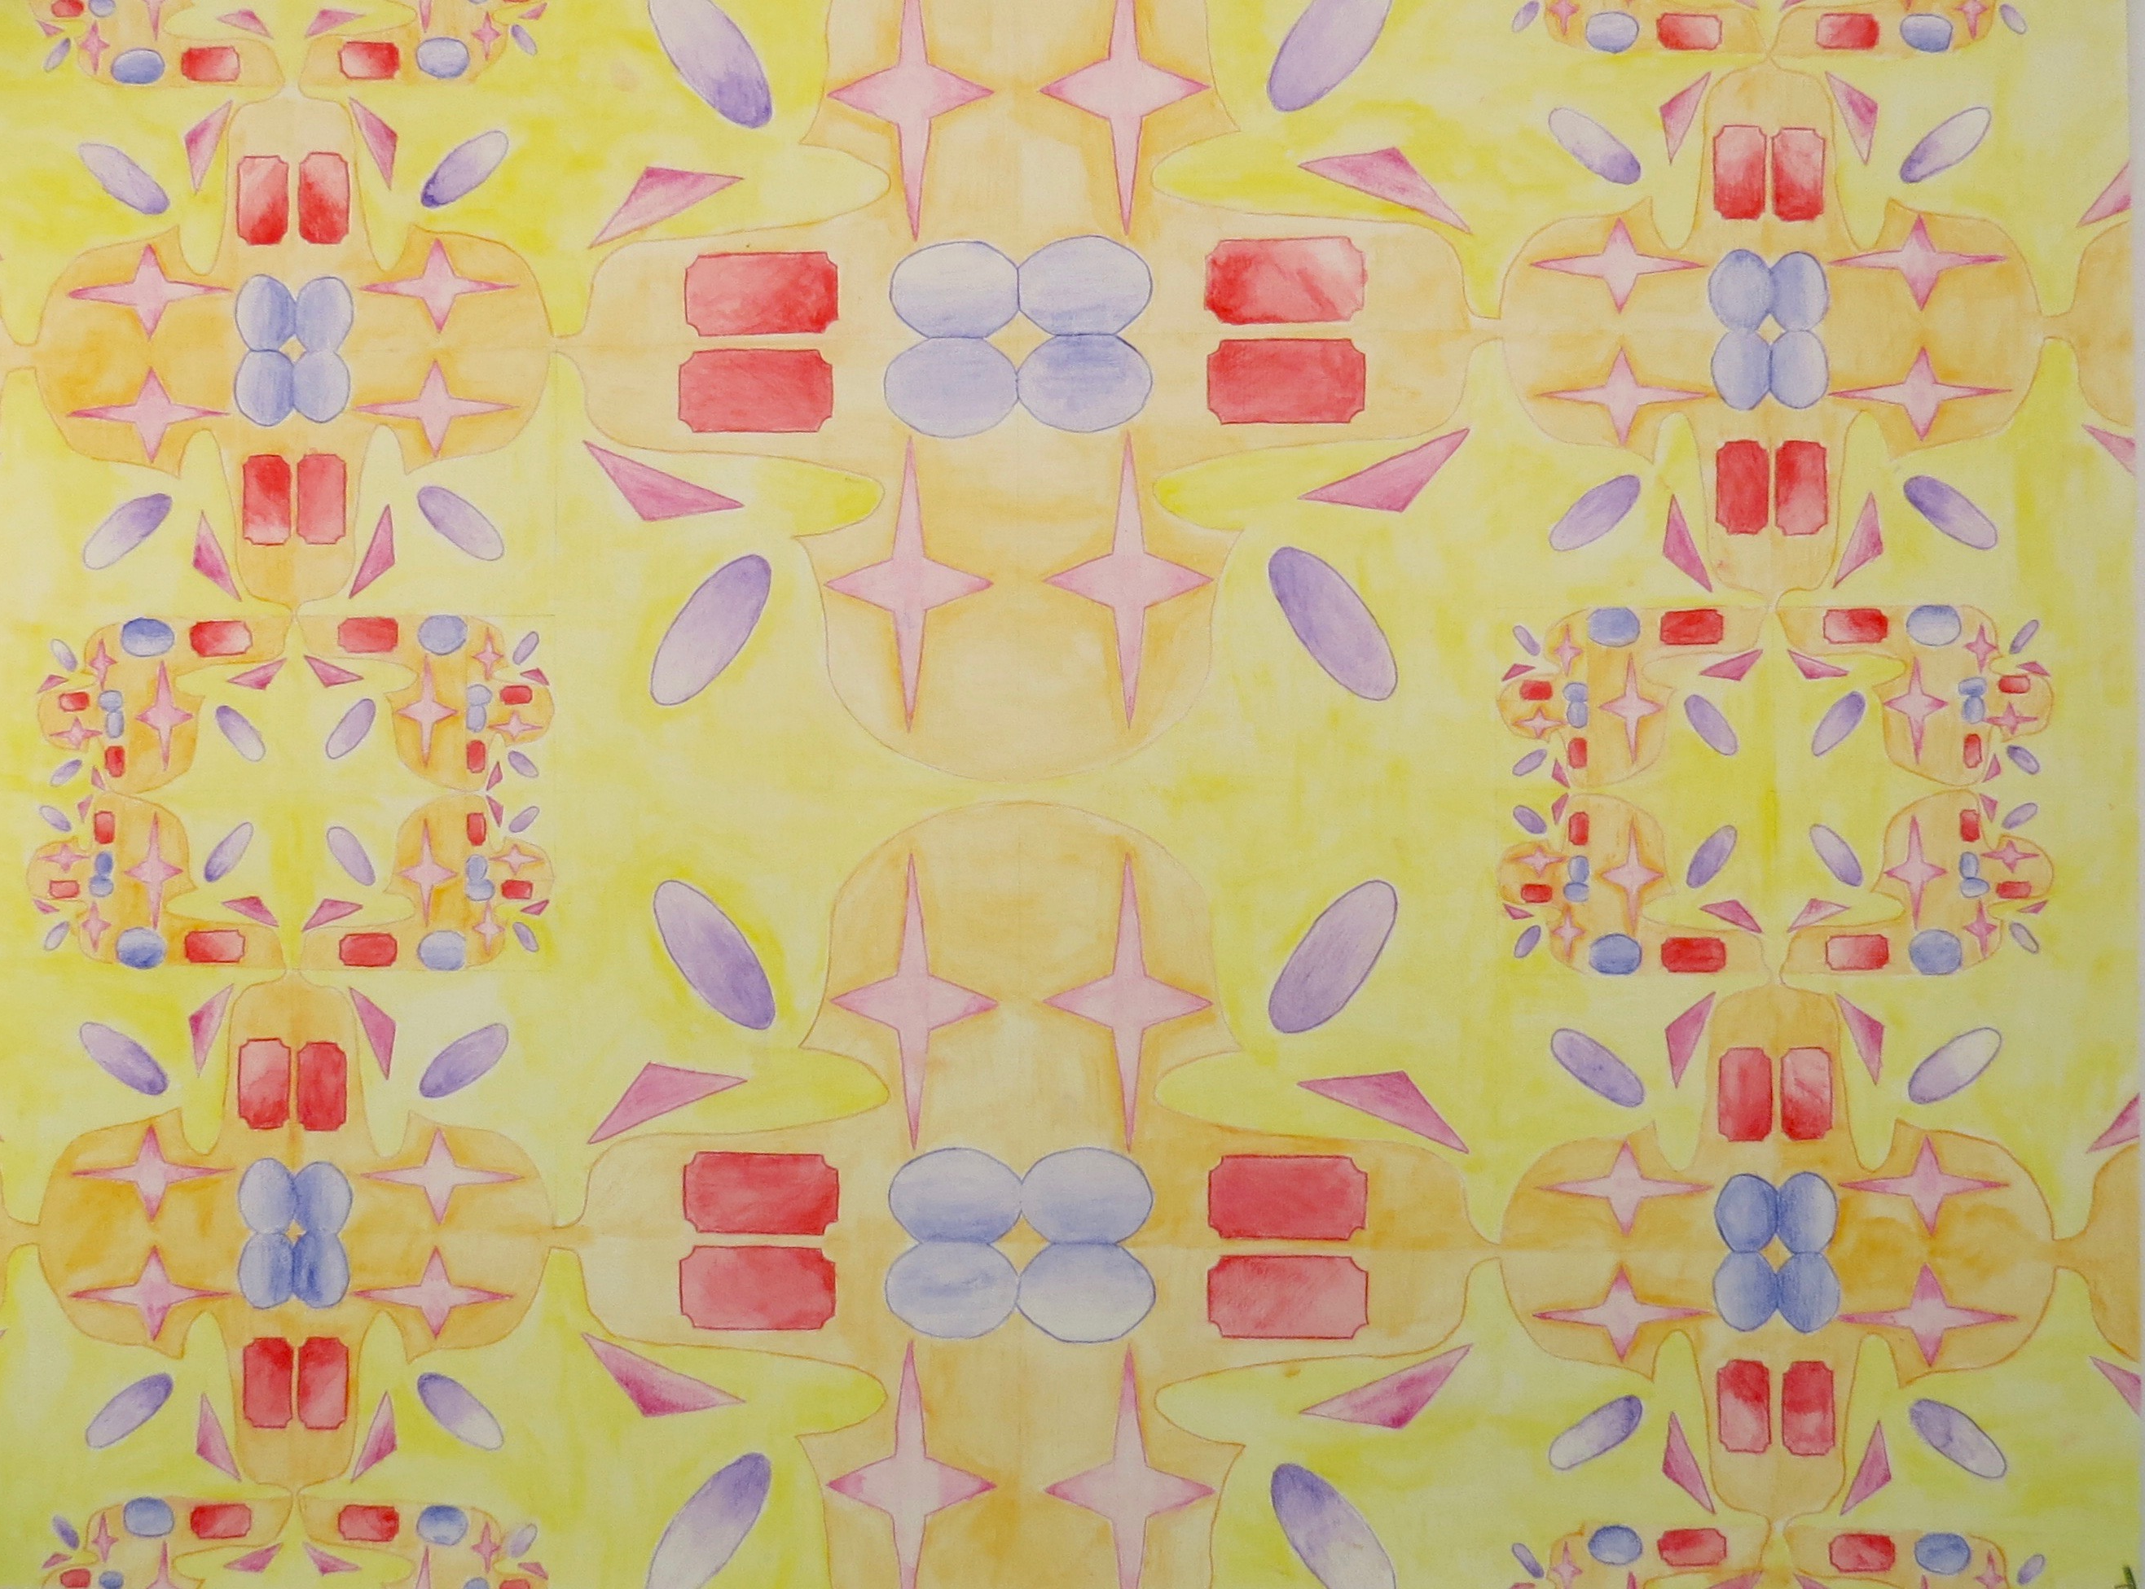
Wolfson High student work 2018-19

Slide 18
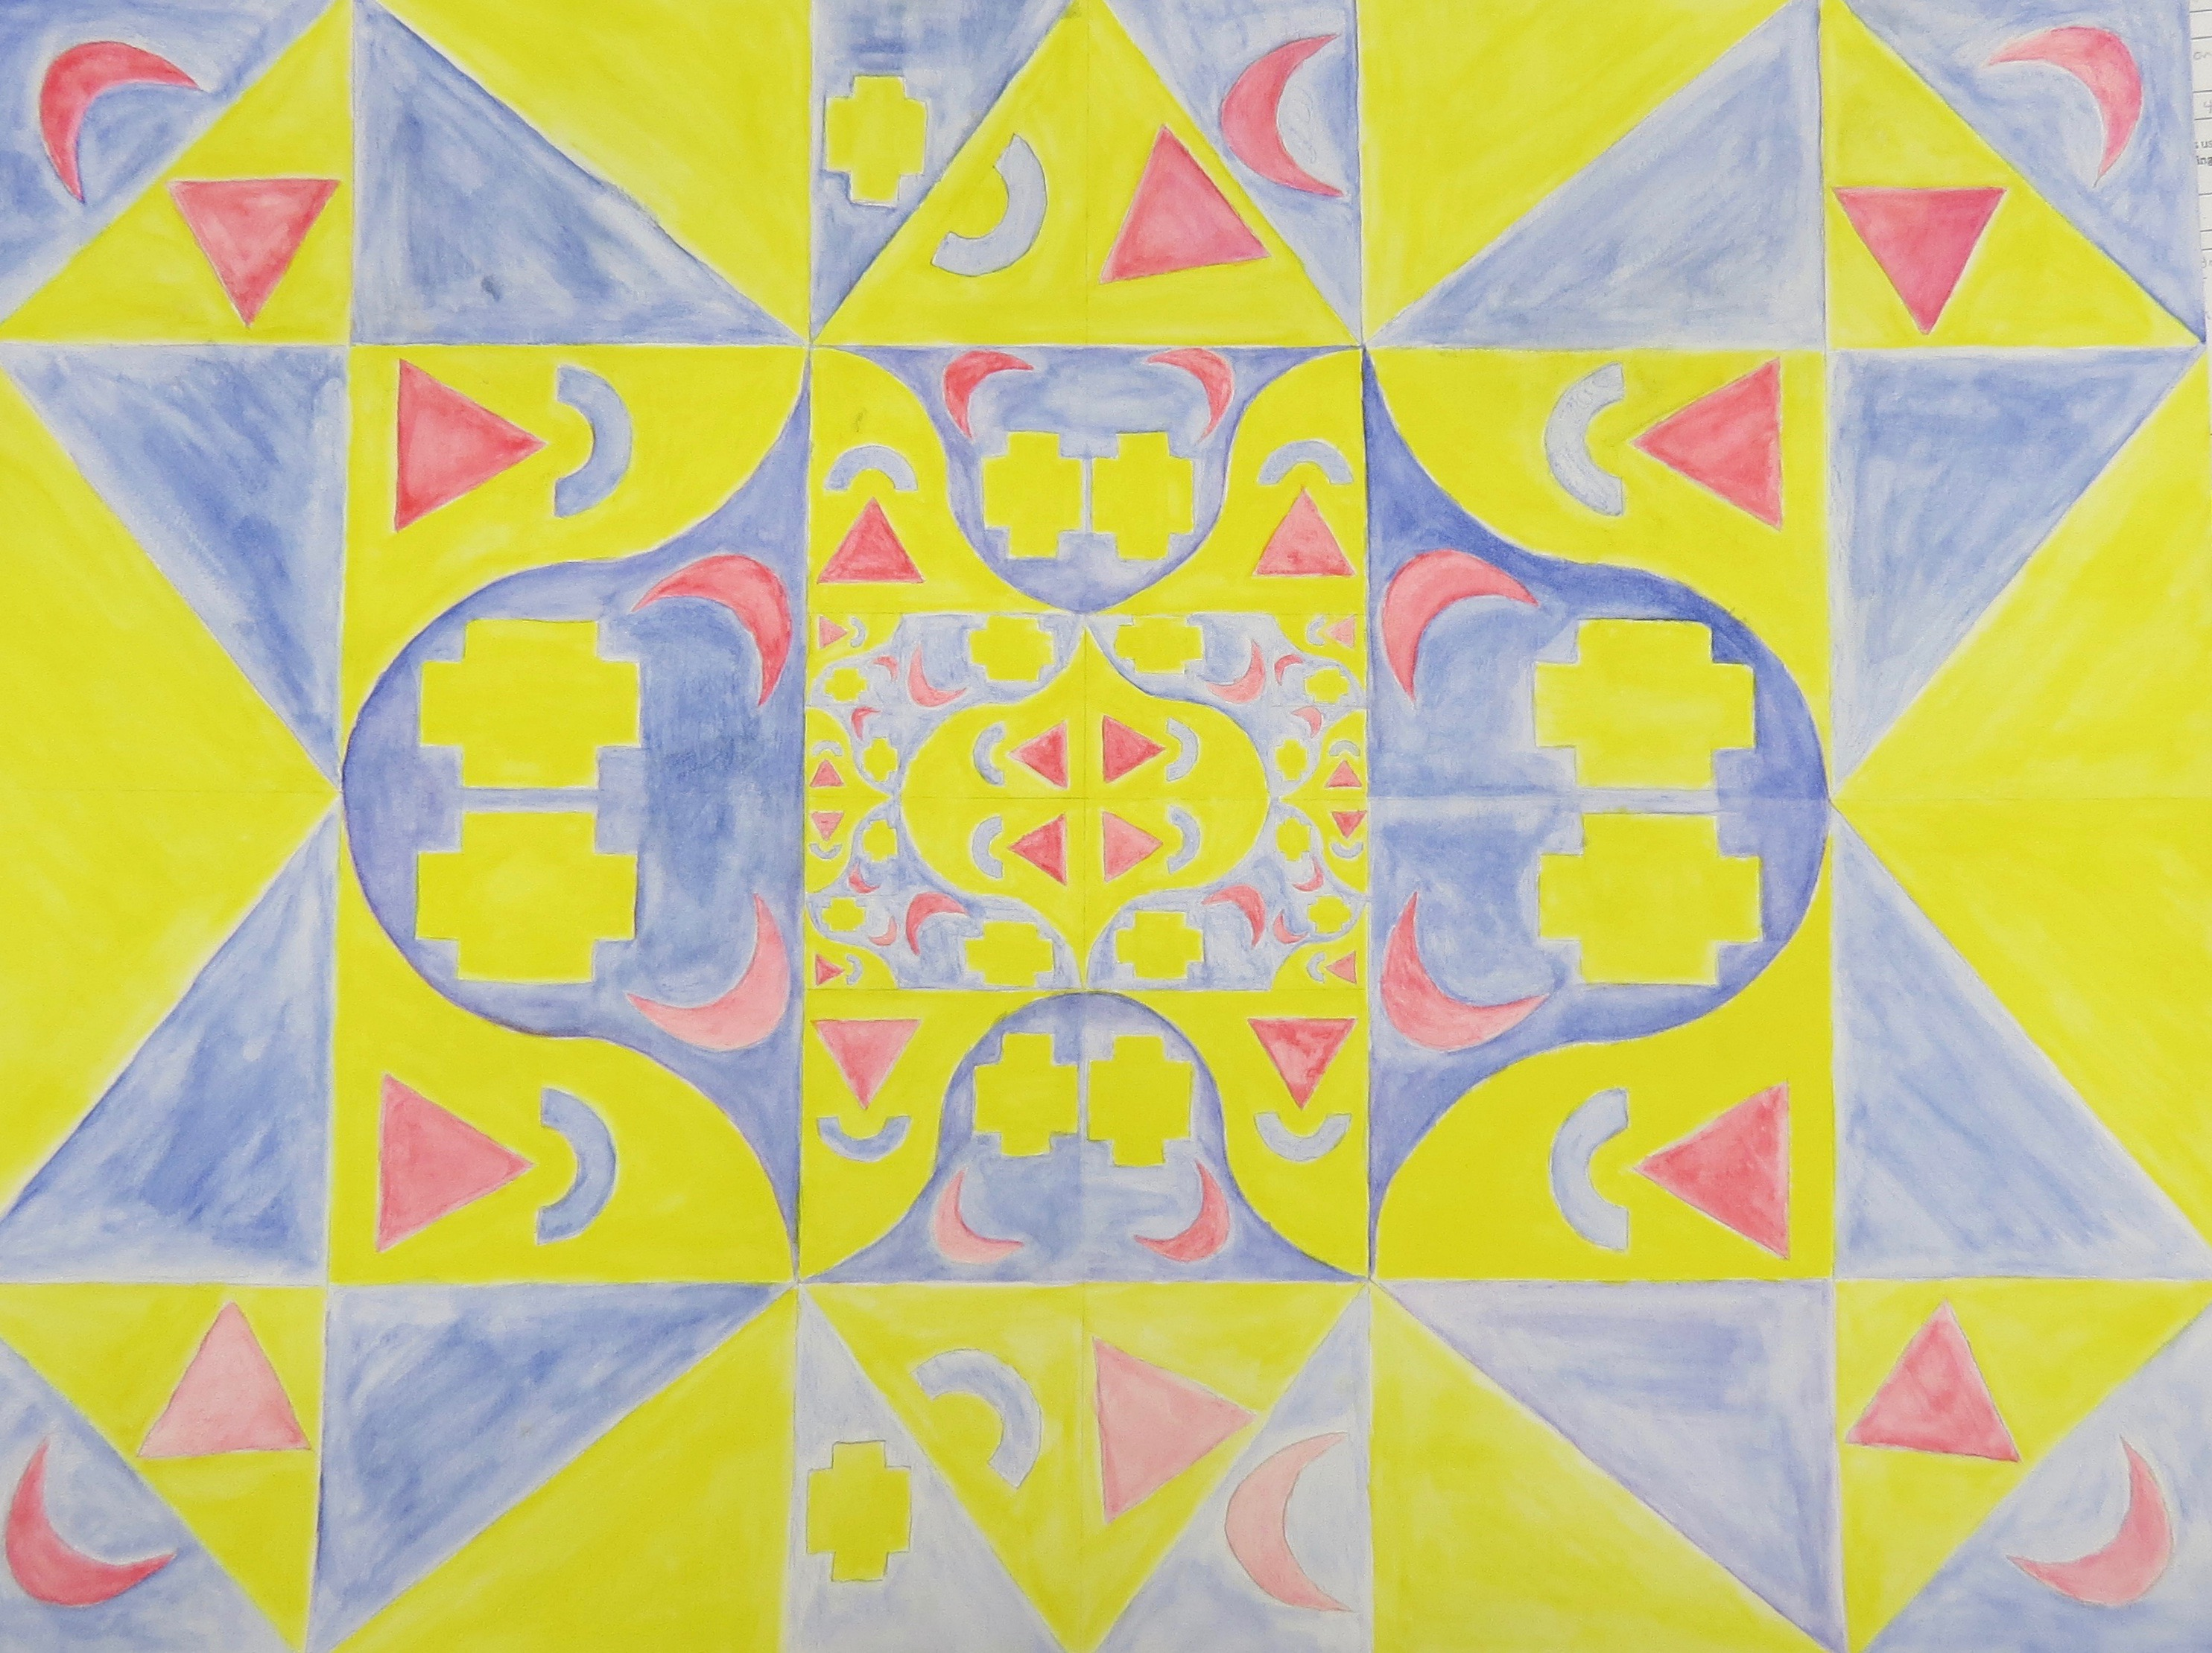
Wolfson High student work 2018-19

Slide 19
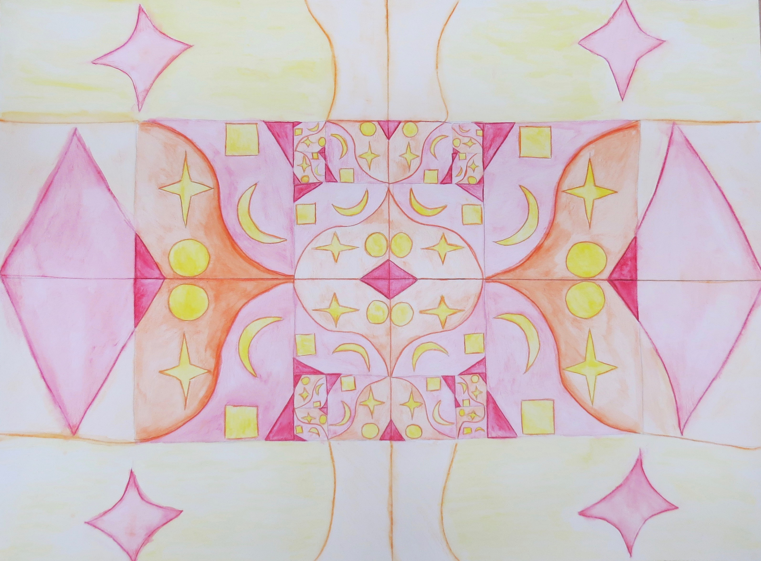
Wolfson High student work 2018-19

