Slide 1
Layered cut paper
Warmup
Compare & contrast

Slide 2
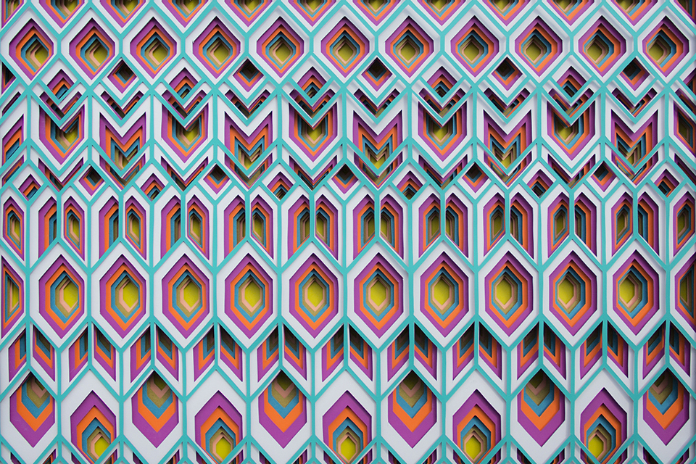
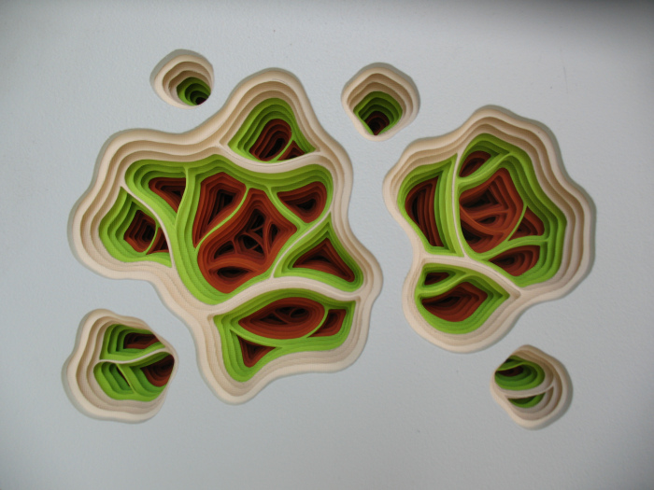
Charles Clary, American b.1980
Drag-a-Diddle Phrenology Movement #1
8″ x 10″ x 4″
Acrylic and Handcut Paper on Panel
Maud Vantorus, French, b.1985
Inca
20 x 24 in
Paper

Slide 3
Describe:
What do you see in both of the artworks?
Drag-a-Diddle Phrenology Movement #1
Inca
Write complete sentences that give specific details to support your answer using correct art terms.

Slide 4
Analyze:
Compare/Contrast the types of shapes the artist used.
How did both artist use repetition and proportion?
Drag-a-Diddle Phrenology Movement #1
Inca
Write complete sentences that give specific details to support your answer using correct art terms.

Slide 5
Interpret:
Compare/Contrast what the artist were trying to tell the viewer?
Drag-a-Diddle Phrenology Movement #1
Inca
Write complete sentences that give specific details to support your answer using correct art terms.

Slide 6
Judge:
Which artist did a better job with the media? Why?
Drag-a-Diddle Phrenology Movement #1
Inca
Write complete sentences that give specific details to support your answer using correct art terms.

