Slide 1
Compare contrast
Clay figures

Slide 2
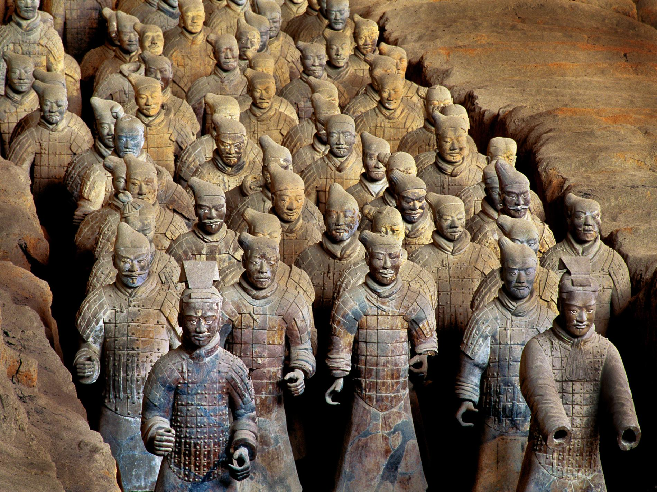
Emperor Quin’s Terra Cotta Army
“Platoons of clay soldiers were buried with China's first emperor, Qin Shi Huang Di, to accompany him during his eternal rest. Production of the army was stopped in 209 B.C. and found buried in a field in 1974.”
Each figure is larger than life size, has a distinct facial feature. Over 8000 figures have been found.
https://www.nationalgeographic.com/archaeology-and-history/archaeology/emperor-qin/#/55318.jpg

Slide 3
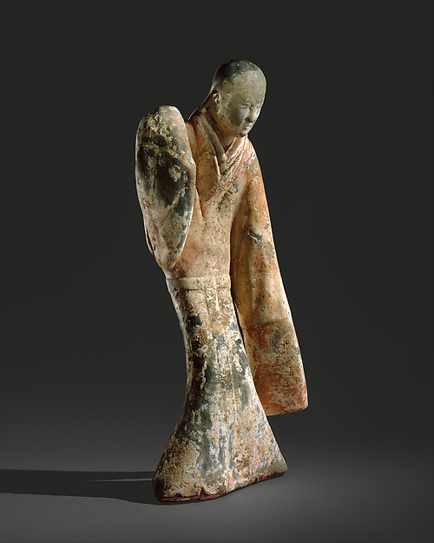
Western Han dynasty (206 B.C. – A.D.9)
China
Female Dancer
Earthenware with slip and pigment 1. 21 in x w 9 ¾ x D. 7 inches
https://www.metmuseum.org/art/collection/search/42178?sortBy=Relevance&amp;ft=clay+figure&amp;offset=0&amp;rpp=50&amp;pos=31

Slide 4
Emperor Quin’s Terra Cotta Army
Compare and Contrast
DESCRIBE the clothing portrayed in these clay figures.
Give details! Remember to defend your answer using complete sentences.
Female Dancer

Slide 5
Emperor Quin’s Terra Cotta Army
Compare and Contrast
ANALYZE use of proportion as compared to a living person in these clay figures.
Give details! Remember to defend your answer using complete sentences.
Female Dancer

Slide 6
Emperor Quin’s Terra Cotta Army
Compare and Contrast
INTERPRET what the clay figures show in the way of power.
Give details! Remember to defend your answer using complete sentences.
Female Dancer

Slide 7
Emperor Quin’s Terra Cotta Army
Compare and Contrast
JUDGE the craftsmanship in these clay figures.
Give details! Remember to defend your answer using complete sentences.
Female Dancer

