Slide 1
coiled basket art
Warm-up 2019

Slide 2
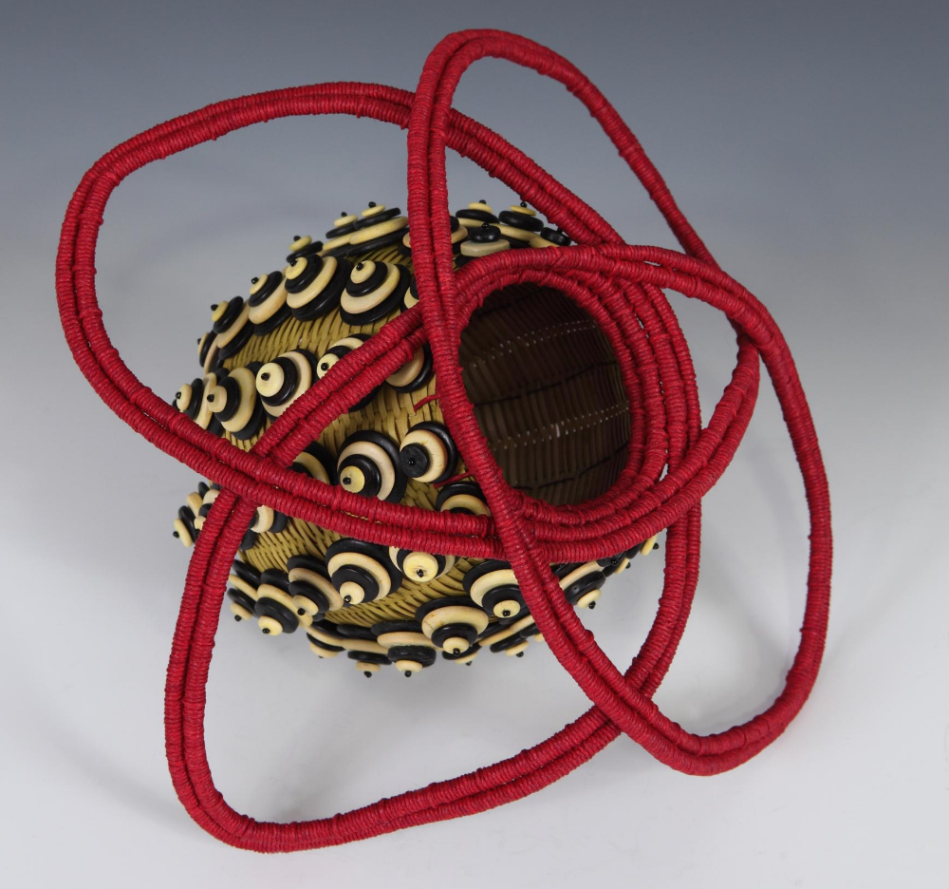
JoAnne Russo
Pod Pollination
Black ash, beads, waxed linen, paper cord, paper, thread
size not given
https://www.metrowestdailynews.com/x1155172984/At-Mobilia-Gallery-baskets-are-packed-with-artistry
Give details! Remember to defend your answer using complete sentences.

Slide 3
Describe
What three types of lines did the artist use in this basket?
https://www.metrowestdailynews.com/x1155172984/At-Mobilia-Gallery-baskets-are-packed-with-artistry

Slide 4
Analyze
How did the artist use repetition in this basket?
https://www.metrowestdailynews.com/x1155172984/At-Mobilia-Gallery-baskets-are-packed-with-artistry

Slide 5
Interpret
Why did the artist put layers of buttons on the basket?
https://www.metrowestdailynews.com/x1155172984/At-Mobilia-Gallery-baskets-are-packed-with-artistry

Slide 6
Judge
What grade would you give the artist for the craftsmanship in this basket?
https://www.metrowestdailynews.com/x1155172984/At-Mobilia-Gallery-baskets-are-packed-with-artistry

