Slide 1
Art Criticism
Cornell notes

Slide 2
You will be using your “Art Criticism” worksheet to take notes from this presentation.
YOU MUST USE COLOR PENCILS or color gel pens for these notes.

Slide 3
With each step in Art Criticism you will change the color pencil, gel pens, or font (if typing) being used for the notes!
You do not have to use the same color in this presentation. DO USE YELLOW, but what ever color use use for each stem in Art Criticism all notes for that step must be done in the color you chose.
MindMap© map notes are taken in the same way with colors and images. What you are doing today connects MindMap© with Cornell notes.

Slide 4
Essential Question: What is the Feldman’s approach to Art Criticism?
Answer:
The inclusion of criteria or standards (a simple 4 step structure) for evaluating works created by Edmund Feldman 1970

Slide 5
Credit Line
Select a color pencil or gel pen to take your notes. May be any color except yellow. If typing on a computer select a color for your font.

Slide 6
CREDIT LINE
Artist Name
Year of birth/death
b._ _ _ _ is still alive
Nationality (not race)
In this space you will add your own illustrations. You may not just copy the illustrations in this presentation!
Title of work
Year the art was made
Medium
Materials used to
make the art
This information should be found with the artwork or art image.
Size
Location
Museum, url.
Not google images/pintrest!

Slide 7
1. DESCRIBE
Select a new color to take your notes. May be any color except yellow or a color already used for this worksheet.

Slide 8
1. DESCRIBE
1. Subject Matter
Portrait
Figure Study
Landscape
Still-life
Abstract
In this space you will add your own illustrations. You may not just copy the illustrations in this presentation!
1.What do you see?
2. Foreground
Middle ground
Background
Right/left side
Middle
Top/Bottom
2.Where are the items?

Slide 9
2. ANALYZE
Select a new color to take your notes. May be any color except yellow or a color already used for this worksheet.

Slide 10
2. ANALYZE
1.Which Elements of Art did the artist use?
2.Which Principles of Design were used when making the work?
In this space you will add your own illustrations. You may not just copy the illustrations in this presentation!
How did the artist make the artwork?
3. Give specific details on how they were used!

Slide 11
3. INTERPRET
Select a new color to take your notes. May be any color except yellow or a color already used for this worksheet.

Slide 12
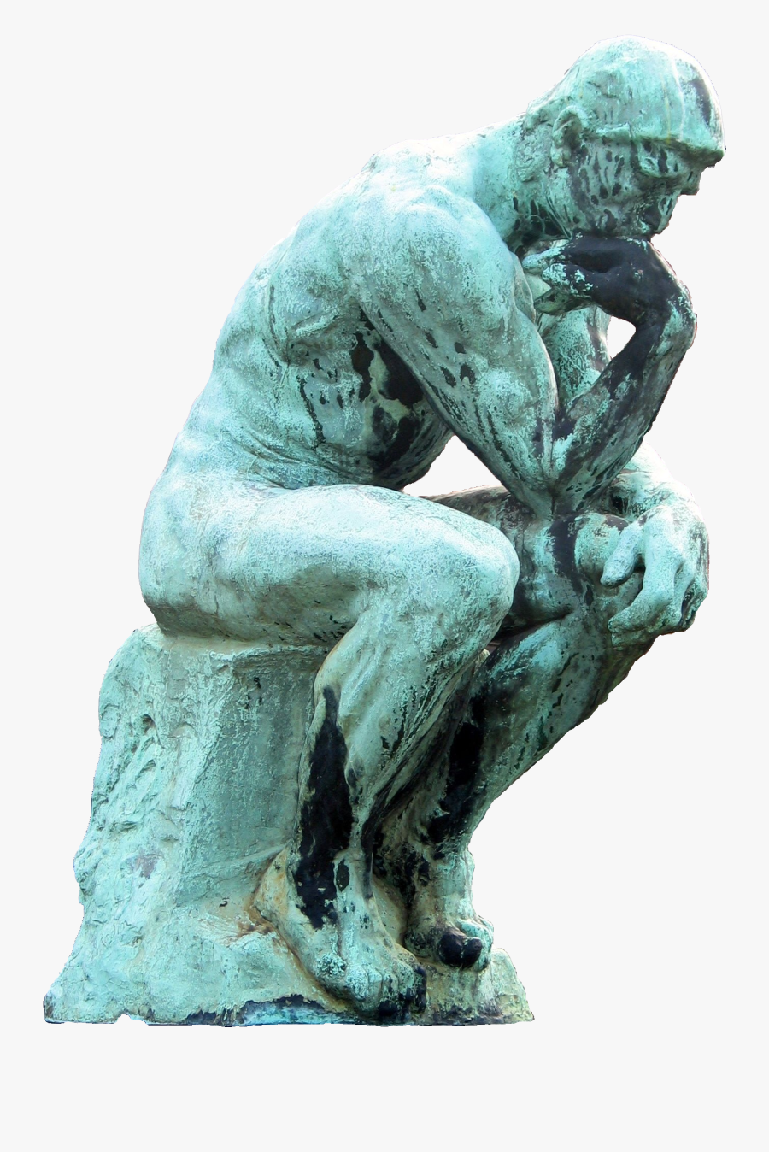
3. INTERPRET
1.Feelings
Mood/Emotions
Political
Personal
History
In this space you will add your own illustrations. You may not just copy the illustrations in this presentation!
What is the artist saying with this piece?
2. Give specific details on why you believe what the artist was saying.

Slide 13
4. JUDGE
Select a new color to take your notes. May be any color except yellow or a color already used for this worksheet.

Slide 14
4. JUDGE
1.How well did the artist used the media chosen for the art?
2.Over all composition?
3. How successful was the artist in his/her communication to the viewer?
In this space you will add your own illustrations. You may not just copy the illustrations in this presentation!
What score would you give the artist?
4. Give specific details how you reached this opinion and why!

Slide 15
You have now finished your written part of the Cornell notes.
Now you need to add your own illustrations to help you remember the notes.
When finished, turn in your paper or upload your work into Focus for grading!

